Slide 1
Simulation & Modelling
CSE-504

Slide 2
Simulation and Modelling
Course Code: | CSE-504 | Credits: | 03
 |  | CIE Marks: | 90
Exam Hours: | 03 | SEE Marks: | 60
Course Learning Outcome (CLOs): After Completing this course successfully, the student will be able to…
CLOs | Description
CLO1 | Understand the basic principles of simulation, its applications, and the distinction between discrete and continuous systems.
CLO2 | Build conceptual, specification, and computational models to represent real-world systems.
CLO3 | Analyze simulation results, interpret statistical outputs, and evaluate performance metrics.
CLO4 | Design and implement discrete-event simulation models using specialized tools and techniques.
CLO5 | Assess system performance through simulation, identifying bottlenecks and exploring “what-if” scenarios.
CLO6 | Validate and verify simulation models to ensure they accurately represent real-world systems.
CLO7 | Use random variables, distributions, and probability functions to model uncertainties in simulations.
CLO8 | Apply simulation techniques to solve practical problems in areas like manufacturing, logistics, and inventory management.

Slide 3
Summary of Course Content
Sl. | Course Content | HRs | CLOs
1 | Introduction to Simulation and System Modeling | 3 | CLO1, CLO2
2 | Advantages and Disadvantages of Simulation | 2 | CLO1, CLO5
3 | Types of Simulations (Monte Carlo, Time-Stepped, Discrete-Event) | 4 | CLO1, CLO4
4 | Monte Carlo Simulation: Concepts and Applications | 3 | CLO4, CLO7
5 | Simulation Model Taxonomy (Static, Dynamic, Continuous, Discrete) | 2 | CLO2, CLO5
6 | Discrete-Event Simulation (DES) Components and Examples | 4 | CLO4, CLO6
7 | Statistical Aspects: Random Variables & Distributions | 3 | CLO3, CLO7
8 | Chi-Square Test for Validation | 2 | CLO6, CLO7
9 | Verification and Validation of Simulation Models | 3 | CLO6
10 | Applications of Simulation in Real-World Problems | 3 | CLO5, CLO8
11 | Case Studies: Queueing Systems and Inventory Models | 2 | CLO4, CLO5
Recommended Books:
Simulation Modeling and Analysis: Author: Averill M. Law (5th Edition or latest).
Discrete-Event System Simulation: Authors: Jerry Banks, John S. Carson II, Barry L. Nelson, David M. Nicol.
Theory of Modeling and Simulation: Authors: Bernard P. Zeigler, Herbert Praehofer, Tag Gon Kim.

Slide 4
Assessment Pattern
CIE- Continuous Internal Evaluation (90 Marks)
Bloom's Category Marks (out of 90) | Tests (45) | Assignments (15) | Quizzes (15) | Attendance (15)
Remember | 5 | 03
Understand | 5 | 04 | 05
Apply | 15 | 05 | 05
Analyze | 10
Evaluate | 5 | 03 | 05
Create | 5
SEE- Semester End Examination (60 Marks)
Bloom's Category | Test
Remember | 7
Understand | 7
Apply | 20
Analyze | 15
Evaluate | 6
Create | 5

Slide 5


Course Plan
Week No | Topics | Teaching Learning Strategy(s) | Assessment Strategy(s) | Alignment to CLO
1 | Introduction to Simulation and System Modeling | Lecture, Discussion, Real-World Examples | Quiz on simulation basics | CLO1, CLO2
2 | When Simulation is Appropriate/Not Appropriate | Lecture, Group Discussion | Short written assignment | CLO1
3 | Advantages and Disadvantages of Simulation | Lecture, Case Study Analysis | Group presentation | CLO1, CLO5
4 | Types of Simulations: Overview | Lecture, Class Exercise (Simulation Examples) | Class quiz | CLO1, CLO4
5 | Monte Carlo Simulation: Concept and Applications | Lecture, Numerical Examples, Problem Solving | Problem-solving assignment | CLO4, CLO7
6 | Monte Carlo Simulation: Hands-On Practice | Practical Demonstration, Software Simulation | Practical evaluation | CLO4, CLO7
7 | Simulation Model Taxonomy | Lecture, Diagram Practice | Diagram-based quiz | CLO2, CLO5
8 | Discrete-Event Simulation (DES): Components | Lecture, Flowchart Design, Examples | Flowchart-based exercise | CLO4, CLO6
9 | DES: Single-Server Queue Example | Simulation Software Lab, Group Activity | Practical evaluation | CLO4, CLO6
10 | Statistical Aspects: Random Variables & Distributions | Lecture, Numerical Examples | Class test on distributions | CLO3, CLO7
11 | Chi-Square Test for Validation | Lecture, Hands-On Calculation, Examples | Assignment on Chi-Square Test | CLO6, CLO7
12 | Verification and Validation of Simulation Models | Lecture, Validation Exercises, Examples | Model validation report | CLO6
13 | Performance Analysis in Simulation | Lecture, Case Study Discussion | Short report on performance metrics | CLO5
14 | Applications of Simulation in Real-World Problems | Lecture, Case Study Presentation | Group presentation | CLO5, CLO8
15 | Case Study: Queueing Systems and Inventory Models | Simulation Lab, Practical Exercises | Practical evaluation | CLO4, CLO5
16 | Common Mistakes in Simulation | Lecture, Group Activity | Short reflective report | CLO3, CLO6
17 | Review and Final Assessment | Revision, Q&A Session | Final Exam | CLO1, CLO2, CLO3, CLO4, CLO5, CLO6, CLO7, CLO8

Slide 6
Week 1
Slides 6-13

Slide 7
Lecture 1
Chapter-01
Discrete-Event System Simulation
Introduction to Simulation

Slide 8
Introduction to Simulation
A set of assumptions
Real-world process
Modeling & Analysis
concerning the behavior of a system
Simulation
  the imitation of the operation of a real-world process or system over time
  to develop a set of assumptions of mathematical, logical, and symbolic relationship between the entities of interest, of the system.
  to estimate the measures of performance of the system with the simulation-generated data
Simulation modeling can be used
  as an analysis tool for predicting the effect of changes to existing systems
  as a design tool to predict the performance of new systems

Slide 9
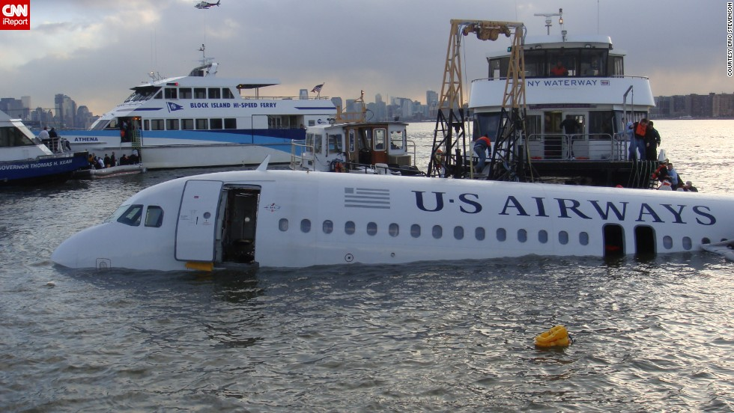
Miracle on the
Hudson in 2009
with 155
passengers

Slide 10
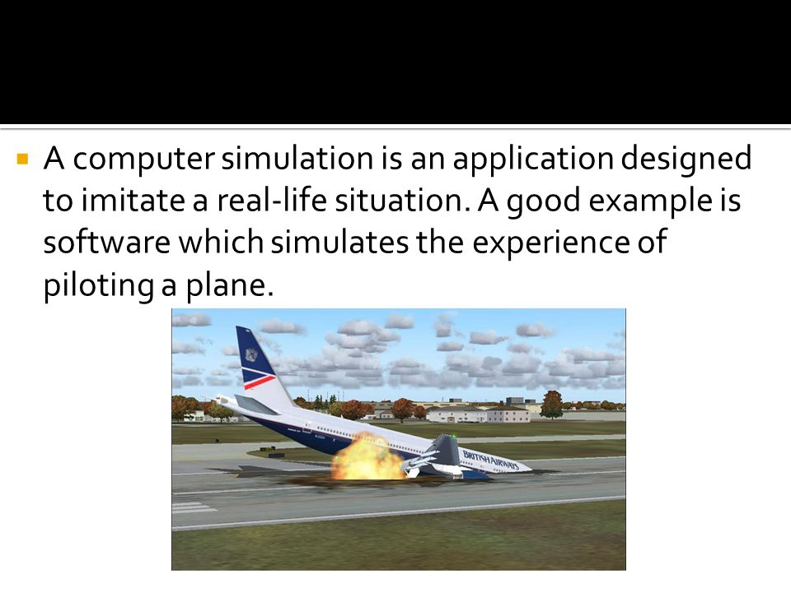

Slide 11
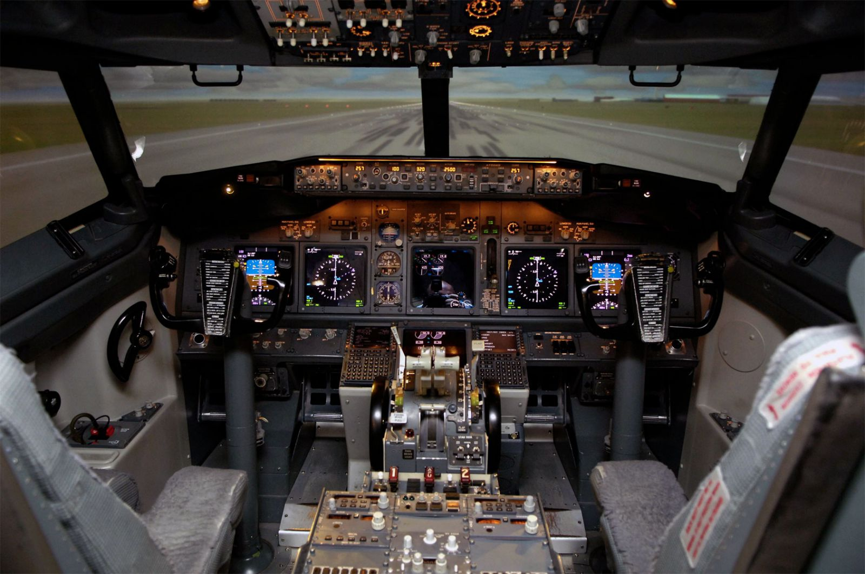

Slide 12
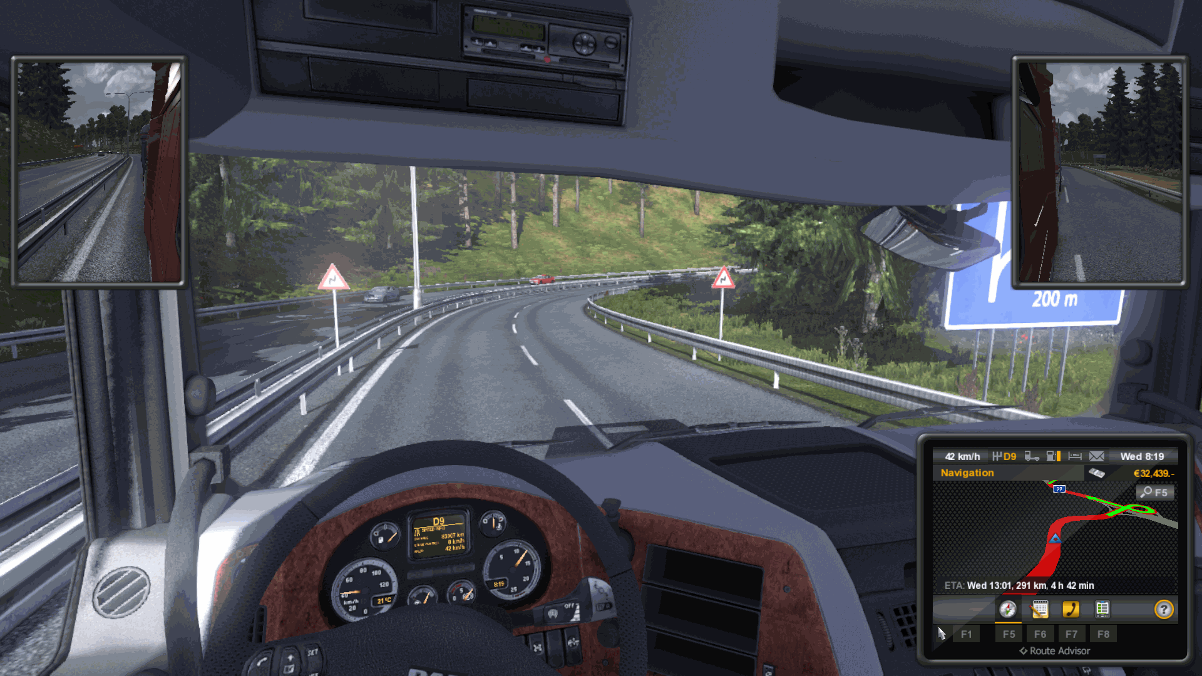

Slide 13
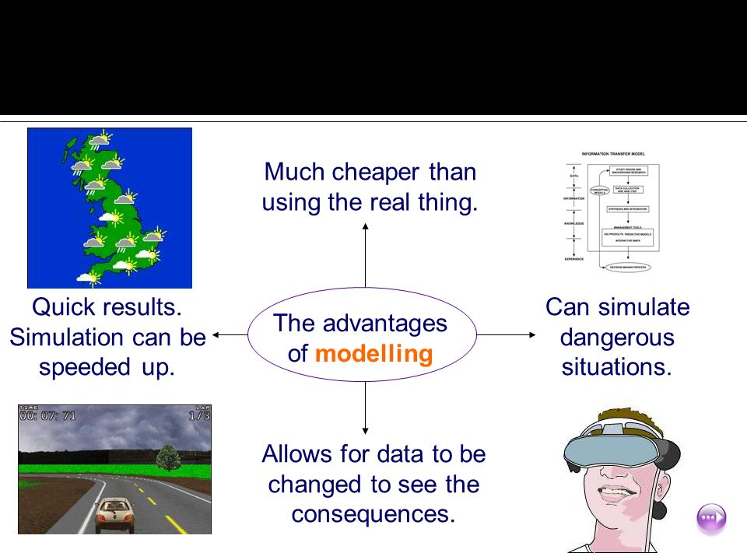

Slide 14
Week 2
Slides 14-23

Slide 15
When Simulation is the Appropriate Tool (1)
Simulation enables the study of, and experimentation with, the internal interactions of a complex system, or of a subsystem within a complex system.
Informational, organizational, and environmental changes can be simulated, and the effect of these alterations on the model’s behavior can be observed.
The knowledge gained in designing a simulation model may be of great value toward suggesting improvement in the system under investigation.
By changing simulation inputs and observing the resulting outputs, valuable insight may be obtained into which variables are most important and how variables interact.
Simulation can be used as a pedagogical device to reinforce analytic solution methodologies.

Slide 16
When Simulation is the Appropriate Tool (2)
Simulation can be used to experiment with new designs or policies prior to implementation, so as to prepare for what may happen.
Simulation can be used to verify analytic solutions.
By simulating different capabilities for a machine, requirements can be determined.
Simulation models designed for training allow learning without the cost and disruption of on-the-job learning.
Animation shows a system in simulated operation so that the plan can be visualized.
The modern system (factory, wafer fabrication plant, service organization, etc.) is so complex that the interactions can be treated only through simulation.

Slide 17
When Simulation is not Appropriate
When the problem can be solved using common sense.
When the problem can be solved analytically.
When it is easier to perform direct experiments.
When the simulation costs exceed the savings.
When the resources or time are not available.
When system behavior is too complex or can’t be defined.
When there isn’t the ability to verify and validate the model.

Slide 18
Advantages and Disadvantages of Simulation (1)
Advantages
  New polices, operating procedures, decision rules, information flows, organizational procedures, and so on can be explored without disrupting ongoing operations of the real system.
  New hardware designs, physical layouts, transportation systems, and so on, can be tested without committing resources for their acquisition.
  Hypotheses about how or why certain phenomena occur can be tested for feasibility.
  Insight can be obtained about the interaction of variables.
  Insight can be obtained about the importance of variables to the performance of the system.
  Bottleneck analysis can be performed indicating where work-in-process, information, materials, and so on are being excessively delayed.
  A simulation study can help in understanding how the system operates rather than how individuals think the system operates.
  “What-if” questions can be answered. This is particularly useful in the design of new system.

Slide 19
Advantages and Disadvantages of Simulation (2)
Disadvantages
  Model building requires special training. It is an art that is learned over time and through experience. Furthermore, if two models are constructed by two competent individuals, they may have similarities, but it is highly unlikely that they will be the same.
  Simulation results may be difficult to interpret. Since most simulation outputs are essentially random variables (they are usually based on random inputs), it may be hard to determine whether an observation is a result of system interrelationships or randomness.
  Simulation modeling and analysis can be time consuming and expensive. Skimping on resources for modeling and analysis may result in a simulation model or analysis that is not sufficient for the task.
  Simulation is used in some cases when an analytical solution is possible, or even preferable. This might be particularly true in the simulation of some waiting lines where closed-form queueing models are available.

Slide 20
Areas of Application (1)
WSC(Winter Simulation Conference) : http://www.wintersim.org
  Manufacturing Applications
    Analysis of electronics assembly operations
    Design and evaluation of a selective assembly station for high-precision scroll compressor shells
    Comparison of dispatching rules for semiconductor manufacturing using large-facility models
    Evaluation of cluster tool throughput for thin-film head production
    Determining optimal lot size for a semiconductor back-end factory
    Optimization of cycle time and utilization in semiconductor test manufacturing
    Analysis of storage and retrieval strategies in a warehouse
    Investigation of dynamics in a service-oriented supply chain
    Model for an Army chemical munitions disposal facility
  Semiconductor Manufacturing
    Comparison of dispatching rules using large-facility models
    The corrupting influence of variability
    A new lot-release rule for wafer fabs

Slide 21
Areas of Application (2)
    Assessment of potential gains in productivity due to proactive reticle management
    Comparison of a 200-mm and 300-mm X-ray lithography cell
    Capacity planning with time constraints between operations
    300-mm logistic system risk reduction
  Construction Engineering
    Construction of a dam embankment
    Trenchless renewal of underground urban infrastructures
    Activity scheduling in a dynamic, multi-project setting
    Investigation of the structural steel erection process
    Special-purpose template for utility tunnel construction
  Military Application
    Modeling leadership effects and recruit type in an Army recruiting station
    Design and test of an intelligent controller for autonomous underwater vehicles
    Modeling military requirements for nonwarfighting operations
    Multi-trajectory performance for varying scenario sizes
    Using adaptive agent in U.S Air Force pilot retention

Slide 22
Areas of Application (3)
  Logistics, Transportation, and Distribution Applications
    Evaluating the potential benefits of a rail-traffic planning algorithm
    Evaluating strategies to improve railroad performance
    Parametric modeling in rail-capacity planning
    Analysis of passenger flows in an airport terminal
    Proactive flight-schedule evaluation
    Logistics issues in autonomous food production systems for extended-duration space exploration
    Sizing industrial rail-car fleets
    Product distribution in the newspaper industry
    Design of a toll plaza
    Choosing between rental-car locations
    Quick-response replenishment

Slide 23
Areas of Application (4)
  Business Process Simulation
    Impact of connection bank redesign on airport gate assignment
    Product development program planning
    Reconciliation of business and systems modeling
    Personnel forecasting and strategic workforce planning
  Human Systems
    Modeling human performance in complex systems
    Studying the human element in air traffic control

Slide 24
Week 3
Slides 24-31

Slide 25
Recap: Performance Evaluation
Performance Evaluation
Performance Measurement
Performance Modeling
Analytic Modeling
Simulation

Slide 26
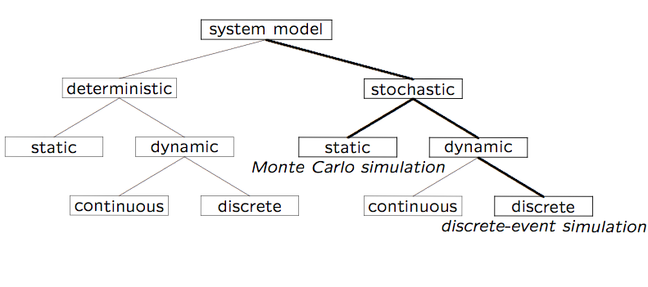
Simulation Model Taxonomy (preview)

Slide 27
Terminology (1 of 2)
A system is defined as a group of objects that interact with each other to accomplish some purpose
  A computer system: CPU, memory, disk, bus, NIC
  An automobile factory: Machines, components parts and workers operate jointly along assembly line
A system is often affected by changes occurring outside the system: system environment
  Hair salon: arrival of customers
  Warehouse: arrival of shipments, fulfilling of orders
    Effect of supply on demand: relationship between factory output from supplier and consumption by customers

Slide 28
Terminology (2 of 2)
Entity
  An object of interest in the system: Machines in factory
Attribute
  The property of an entity: speed, capacity, failure rate
State
  A collection of variables that describe the system in any time: status of machine (busy, idle, down,…)
Event
  An instantaneous occurrence that might change the state of the system: breakdown

Slide 29
Simulation Modeling
Develop a simulation program that implements a computational model of the system of interest
Run the simulation program and use the data collected to estimate the performance measures of interest (often involves the use of randomization)
A system can be studied at an arbitrary level of detail
Quote of the day:
“The hardest part about simulation is deciding what NOT to model.” - Moe Lavigne, Stentor, Summer 1995

Slide 30
Advantages of Simulation
New policies and procedures can be explored without disrupting the ongoing operation of the real system
New designs can be tested without committing resources for their acquisition
Time can be compressed or expanded to allow for a speed-up or slow-down of the phenomenon under study
Insight can be obtained about the interactions of variables, and which ones have the most impact on system performance
Can obtain answers to “What if…” questions

Slide 31
Disadvantages of Simulation
Model building requires special training
  An important role for courses like CPSC 531!!
  Vendors of simulation software have been actively developing packages that contain models that only need input (templates), which simplifies things for users
Simulation results can be difficult to interpret
  Need proper statistical interpretation for output analysis
Simulation modeling and analysis can be time- consuming and expensive, both for the modeler, as well as in compute time (if not done judiciously)

Slide 32
Week 4
Slides 32-41

Slide 33
When Simulation Is Not Appropriate
When the problem can be solved by common sense
When the problem can be solved analytically
When it is easier to perform direct experiments
When cost of simulations exceeds (expected) savings for the real system
When system behavior is too complex (e.g., humans)

Slide 34
Common Mistakes in Simulation
Poor (pseudo) random number generators
  Best to use well-known or well-understood generator
Improper selection of seeds for PRNG
  Short periods; same seeds for all streams
Inappropriate level of detail:
  More detail ➔ more time ➔ more bugs
  More parameters ≠ more accurate
Improperly handled initial conditions (warmup)
Improperly handled ending conditions (cooldown)
Run-length too short to achieve steady-state
  Need proper output analysis, confidence intervals
Notes:
* Move to later slides

Slide 35
Types of Simulations
Monte Carlo simulation
Time-stepped simulation
Trace-driven simulation
Discrete-event simulation
Continuous simulation

Slide 36
Simulation Model Taxonomy

Slide 37
Simulation Examples
Monte Carlo simulation
  Estimating π
  Craps (dice game)
Time-stepped simulation
  Mortgage scenarios
Trace-driven simulation
  Single-server queue (ssq1.c)
Discrete-event simulation
  Witchcraft hair salon

Slide 38
Monte Carlo Simulation
Named after Count Montgomery de Carlo, who was a famous Italian gambler and random-number generator (1792-1838).
Static simulation (no time dependency)
To model probabilistic phenomenon
Can be used for evaluating non-probabilistic expressions using probabilistic methods
Can be used for estimating quantities that are “hard” to determine analytically or experimentally

Slide 39
Trace-Driven Simulation
Trace = time-ordered record of events in system
Trace-driven simulation = Trace input
Often used in evaluating or tuning resource management algorithms (based on real workloads):
  Paging, cache analysis, CPU scheduling, deadlock prevention, dynamic storage allocation
Example: Trace = start time + duration of processes
Example: Trace = size in bytes of file written to disk
Example: Trace = mobile device ID and call duration

Slide 40
Advantages of Trace-Driven Simulations
Credibility
Easy validation: compare simulation with measurement
Accurate workload: models correlation and interference
Fair comparison: better than random input
Similarity to the actual implementation:
  trace-driven model is similar to the system
  can understand complexity of implementation

Slide 41
Disadvantages of Trace-Driven Simulations
Complexity: more detailed
Representativeness: workload changes with time, equipment
Data Collection: few minutes fill up a disk
Instrumentation: granularity; intrusiveness
Single Point of Validation: one trace = one point
Difficult to change workload

Slide 42
Week 5
Slides 42-49

Slide 43
Discrete-Event Simulation
A simulation model with three features:
  Stochastic:
  some variables in the simulation model are random
  Dynamic:
  system state evolves over time
  Discrete-Event:
  changes in system state occur at discrete time instances

Slide 44
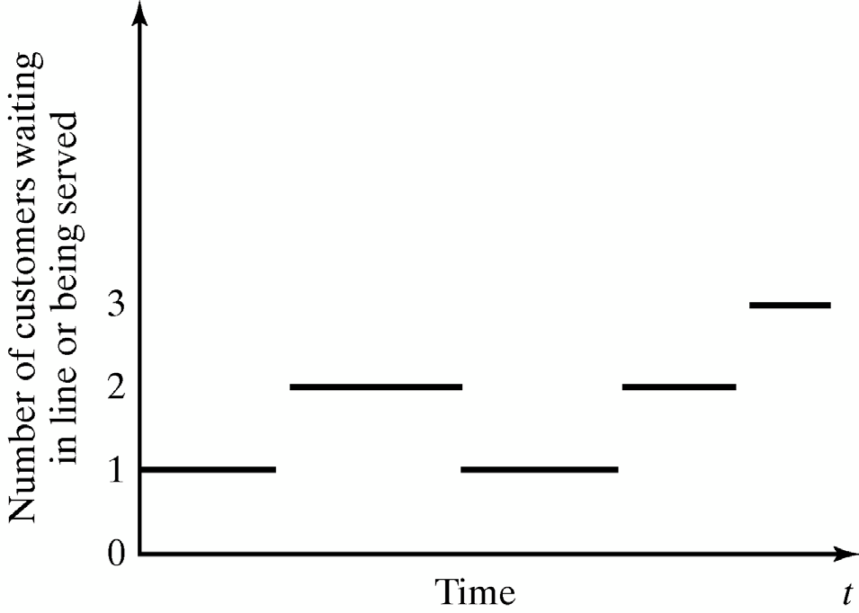
Discrete and Continuous Systems
A discrete system is one in which the system state changes only at a discrete set of points in time
  Example: A restaurant

Slide 45
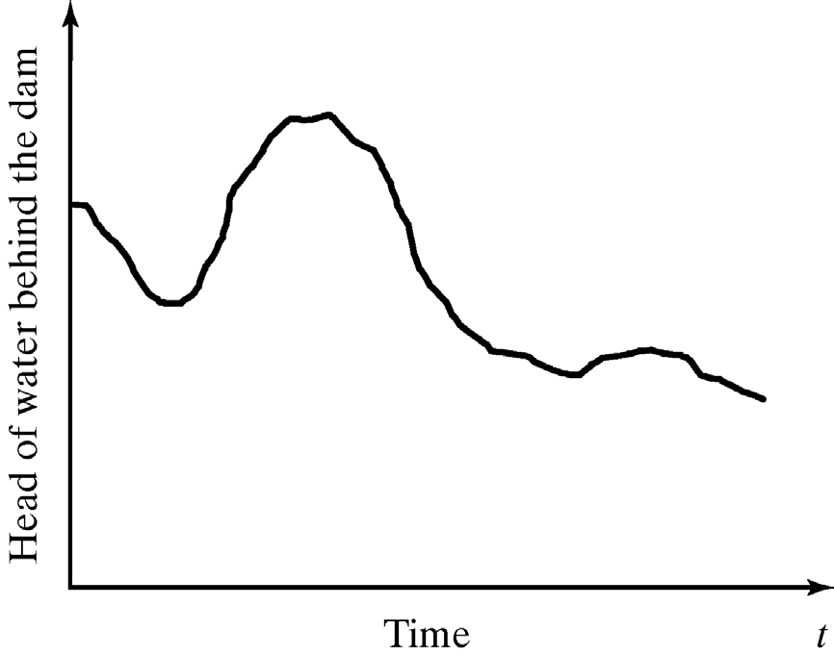
Discrete and Continuous Systems
A continuous system is one in which the system state changes continuously over time
  Example: Water level in Bow River (or Bearspaw dam)

Slide 46
Discrete-Event Simulation
A simulation model in which system state evolves over a discrete sequence of events in time
  System state changes only when an event occurs
  System state does not change between the events
Arrival
Departure
Arrival
Arrival
Restaurant Example

Slide 47
Continuous Simulation
A simulation model in which system state evolves continuously over time
  Time is divided to small time slices
  System state changes in every time slice
Dam Example

Slide 48
Characterizing a Simulation Model
Deterministic or Stochastic
  Does the model contain stochastic components?
Static or Dynamic
  Is time a significant variable?
Continuous or Discrete
  Does the system state evolve continuously or only at discrete points in time?

Slide 49
Simulation Model Taxonomy

Slide 50
Week 6
Slides 50-54

Slide 51
DES Model Development
How to develop a simulation model:
  Determine the goals and objectives
  Build a conceptual model
  Convert into a specification model
  Convert into a computational model
  Verify the model
  Validate the model
Typically an iterative process

Slide 52
Three Model Levels
Conceptual Model
  Very high level (perhaps schematic diagram)
  How comprehensive should the model be?
  What are the state variables?
  Which ones are dynamic, and which are most important?
Specification Model
  On paper: entitites, interactions, requirements, rules, etc.
  May involve equations, pseudocode, etc.
  How will the model receive input?
Computational Model
  A computer program
  General-purpose programming language or simulation language?

Slide 53
Simulation Software
General purpose programming languages
  Flexible and familiar
  Well suited for learning DES principles and techniques
  E.g., C++, Java
Simulation programming languages
  Good for building models quickly
  Provide built-in features (e.g., queue structures)
  Graphics and animation provided
  Domain specific
    Network protocol simulation: ns2, Opnet
    Electrical power simulation: ETAP
    Design and engineering: Ansys, Autodesk
    Process simulation: Simul8

Slide 54
Verification and Validation
Verification
  Computational model should be consistent with specification model
  Did we build the model right?
Validation
  Computational model should be consistent with the system being analyzed
  Did we build the right model?
  Can an expert distinguish simulation output from system output?

Slide 55
Week 7
Slides 55-60

Slide 56
Components and Organization of a Discrete-Event
Simulation Model

Slide 57
Components of a Discrete Event Simulation Model
System state
  The collection of state variables necessary to describe the system at a particular time
Simulation clock
  A variable giving the current value of simulated time
Event list
  A list containing the next time when each type of event will occur
Statistical counters
  Variables used for storing statistical information about system performance

Slide 58
Components of a Discrete Event Simulation Model
Initialization routine
  A subprogram to initialize the simulation model at time 0
Timing routine
  A subprogram that determines the next event from the event list and then advances the simulation clock to the time when that event is to occur
Event routine
  A subprogram that updates the system state when a particular type of event occurs (there is one event routine for each event type)
Library routines
  A set of subprograms used to generate random observations from probability distributions that were determined as part of the simulation model

Slide 59
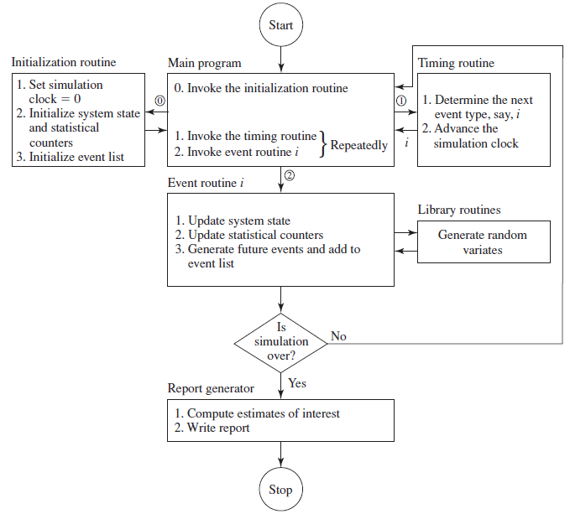
Organization of a Discrete Event Simulation Model

Slide 60
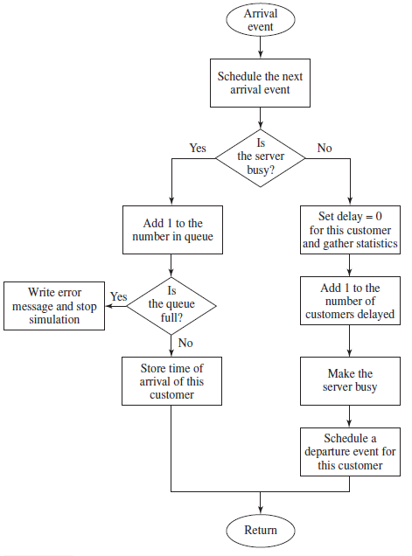
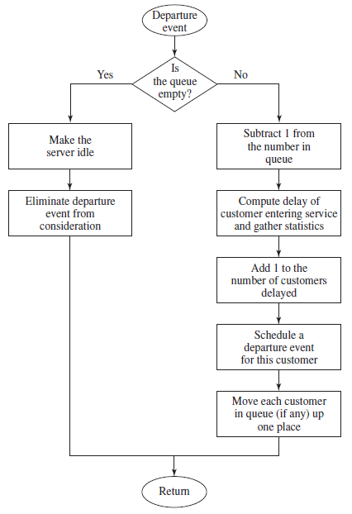
Flowcharts for arrival and departure routines

Slide 61
Week 8
Slides 61-101

Slide 62
Basic Simulation Modeling

Slide 63
Ways to study a system
System
Experiment with the actual system
Experiment with a model of the system
Physical Model
Mathematical Model
Analytical Solution
Simulation

Slide 64
Discrete Event Simulation

Slide 65
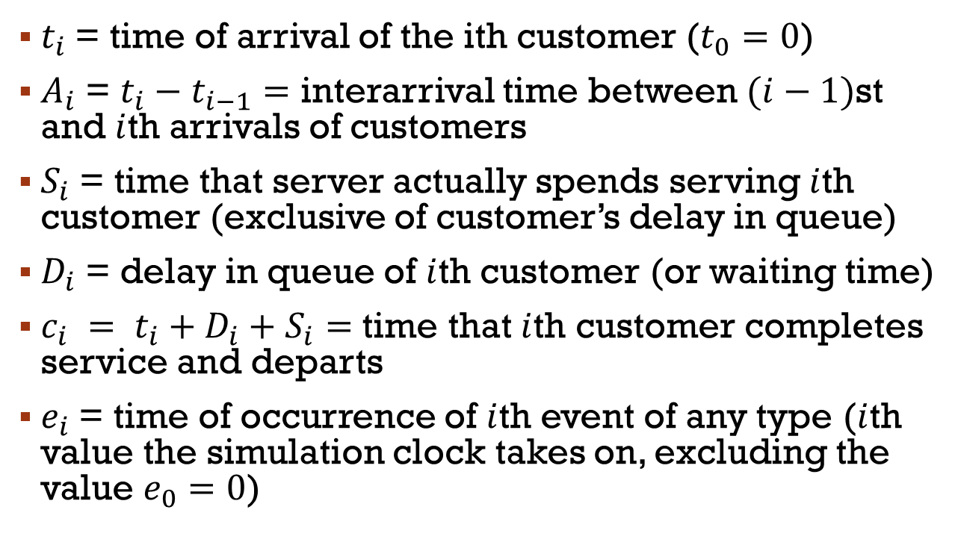
Single Server Queuing System
Server
$t_{i}$= time of arrival of the ith customer ($t_{0}=0$)
$A_{i}$ = $t_{i}−t_{i−1}=$ interarrival time between $(i−1)$st and $i$th arrivals of customers
$S_{i}$ = time that server actually spends serving $i$th customer (exclusive of customer’s delay in queue)
$D_{i}$ = delay in queue of $i$th customer (or waiting time)
$c_{i} = t_{i}+D_{i}+S_{i}=$ time that $i$th customer completes service and departs
$e_{i}$ = time of occurrence of $i$th event of any type ($i$th value the simulation clock takes on, excluding the value $e_{0}=0$)
Customer
Customer in service
Arriving customer
Departing customer

Slide 66
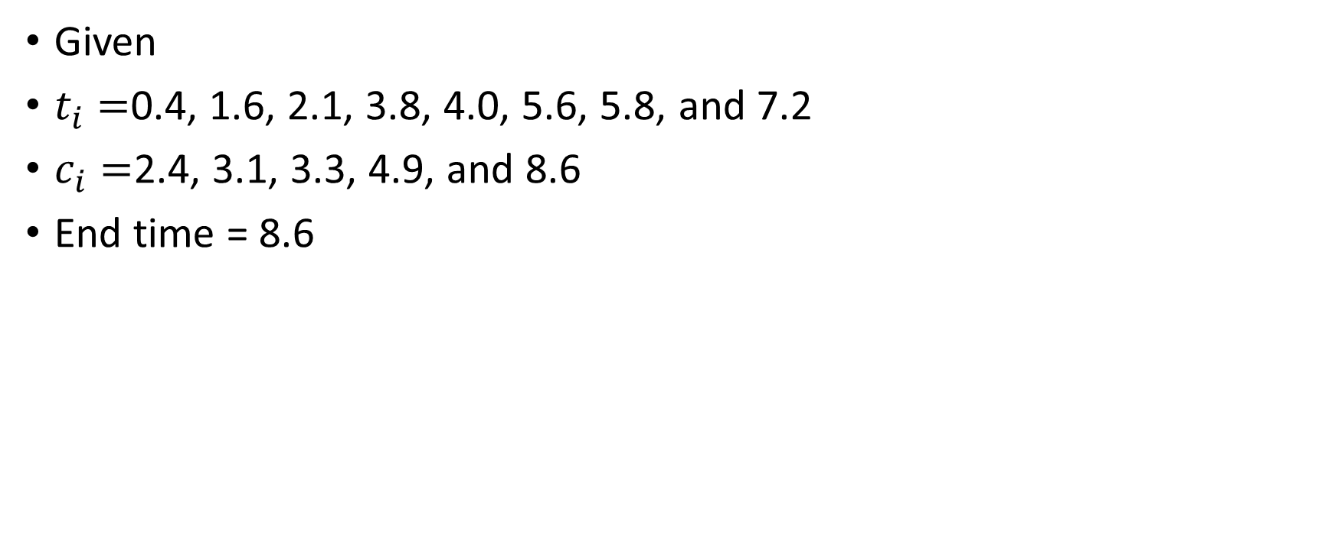
Single Server Queuing System
Given
$t_{i}=$0.4, 1.6, 2.1, 3.8, 4.0, 5.6, 5.8, and 7.2
$c_{i}=$2.4, 3.1, 3.3, 4.9, and 8.6
End time = 8.6

Slide 67

Simulation start…
$$e_{0}$$
0
1
2
3
4
5
6
7
8
9

Slide 68


Customer arrives, takes service…
$$e_{0}$$
$$e_{1}$$
0
0.4
1
2
3
4
5
6
7
8
9
$$t_{1}$$

Slide 69


Another customer arrives and waits…
$$e_{0}$$
$$e_{1}$$
$$e_{2}$$
0
0.4
1
1.6
2
3
4
5
6
7
8
9
$$t_{1}$$
$$t_{2}$$

Slide 70


Another customer arrives and waits…
$$e_{0}$$
$$e_{1}$$
$$e_{2}$$
$$e_{3}$$
0
0.4
1
1.6
2
2.1
3
4
5
6
7
8
9
$$t_{1}$$
$$t_{2}$$
$$t_{3}$$

Slide 71


A customer leaves, another takes service…
$$e_{0}$$
$$e_{1}$$
$$e_{2}$$
$$e_{3}$$
$$e_{4}$$
0
0.4
1
1.6
2
2.1
2.4
3
4
5
6
7
8
9
$$t_{1}$$
$$t_{2}$$
$$t_{3}$$
$$c_{1}$$

Slide 72


Another customer leaves…
$$e_{0}$$
$$e_{1}$$
$$e_{2}$$
$$e_{3}$$
$$e_{4}$$
$$e_{5}$$
0
0.4
1
1.6
2
2.1
2.4
3
4
5
6
7
8
9
3.1
$$t_{1}$$
$$t_{2}$$
$$t_{3}$$
$$c_{1}$$
$$c_{2}$$

Slide 73


Another customer leaves…
$$e_{0}$$
$$e_{1}$$
$$e_{2}$$
$$e_{3}$$
$$e_{4}$$
$$e_{5}$$
$$e_{6}$$
0
0.4
1
1.6
2
2.1
2.4
3
4
5
6
7
8
9
3.1
3.3
$$t_{1}$$
$$t_{2}$$
$$t_{3}$$
$$c_{1}$$
$$c_{2}$$
$$c_{3}$$

Slide 74


Customer arrives…
$$e_{0}$$
$$e_{1}$$
$$e_{2}$$
$$e_{3}$$
$$e_{4}$$
$$e_{5}$$
$$e_{6}$$
$$e_{7}$$
0
0.4
1
1.6
2
2.1
2.4
3
4
5
6
7
8
9
3.1
3.3
3.8
$$t_{1}$$
$$t_{2}$$
$$t_{3}$$
$$c_{1}$$
$$c_{2}$$
$$c_{3}$$
$$t_{4}$$

Slide 75


Customer arrives…
$$e_{0}$$
$$e_{1}$$
$$e_{2}$$
$$e_{3}$$
$$e_{4}$$
$$e_{5}$$
$$e_{6}$$
$$e_{7}$$
$$e_{8}$$
0
0.4
1
1.6
2
2.1
2.4
3
4
5
6
7
8
9
3.1
3.3
3.8
$$t_{1}$$
$$t_{2}$$
$$t_{3}$$
$$c_{1}$$
$$c_{2}$$
$$c_{3}$$
$$t_{5}$$
$$t_{4}$$

Slide 76


Customer leaves…
$$e_{0}$$
$$e_{1}$$
$$e_{2}$$
$$e_{3}$$
$$e_{4}$$
$$e_{5}$$
$$e_{6}$$
$$e_{7}$$
$$e_{8}$$
$$e_{9}$$
0
0.4
1
1.6
2
2.1
2.4
3
4
4.9
5
6
7
8
9
3.1
3.3
3.8
$$t_{1}$$
$$t_{2}$$
$$t_{3}$$
$$c_{1}$$
$$c_{2}$$
$$c_{3}$$
$$t_{5}$$
$$t_{4}$$
$$c_{4}$$

Slide 77


Customer arrives…
$$e_{0}$$
$$e_{1}$$
$$e_{2}$$
$$e_{3}$$
$$e_{4}$$
$$e_{5}$$
$$e_{6}$$
$$e_{7}$$
$$e_{8}$$
$$e_{9}$$
$$e_{10}$$
0
0.4
1
1.6
2
2.1
2.4
3
4
4.9
5
5.6
6
7
8
9
3.1
3.3
3.8
$$t_{1}$$
$$t_{2}$$
$$t_{3}$$
$$c_{1}$$
$$c_{2}$$
$$c_{3}$$
$$t_{5}$$
$$t_{6}$$
$$t_{4}$$
$$c_{4}$$

Slide 78


Customer arrives…
$$e_{0}$$
$$e_{1}$$
$$e_{2}$$
$$e_{3}$$
$$e_{4}$$
$$e_{5}$$
$$e_{6}$$
$$e_{7}$$
$$e_{8}$$
$$e_{9}$$
$$e_{10}$$
$$e_{11}$$
0
0.4
1
1.6
2
2.1
2.4
3
4
4.9
5
5.6
5.8
6
7
8
9
3.1
3.3
3.8
$$t_{1}$$
$$t_{2}$$
$$t_{3}$$
$$c_{1}$$
$$c_{2}$$
$$c_{3}$$
$$t_{5}$$
$$t_{6}$$
$$t_{7}$$
$$t_{4}$$
$$c_{4}$$

Slide 79


Customer arrives…
$$e_{0}$$
$$e_{1}$$
$$e_{2}$$
$$e_{3}$$
$$e_{4}$$
$$e_{5}$$
$$e_{6}$$
$$e_{7}$$
$$e_{8}$$
$$e_{9}$$
$$e_{10}$$
$$e_{11}$$
$$e_{12}$$
0
0.4
1
1.6
2
2.1
2.4
3
4
4.9
5
5.6
5.8
6
7
7.2
8
9
3.1
3.3
3.8
$$t_{1}$$
$$t_{2}$$
$$t_{3}$$
$$c_{1}$$
$$c_{2}$$
$$c_{3}$$
$$t_{5}$$
$$t_{6}$$
$$t_{7}$$
$$t_{4}$$
$$c_{4}$$
$$t_{8}$$

Slide 80


Customer leaves…
$$e_{0}$$
$$e_{1}$$
$$e_{2}$$
$$e_{3}$$
$$e_{4}$$
$$e_{5}$$
$$e_{6}$$
$$e_{7}$$
$$e_{8}$$
$$e_{9}$$
$$e_{10}$$
$$e_{11}$$
$$e_{12}$$
$$e_{13}$$
0
0.4
1
1.6
2
2.1
2.4
3
4
4.9
5
5.6
5.8
6
7
7.2
8
8.6
9
3.1
3.3
3.8
$$t_{1}$$
$$t_{2}$$
$$t_{3}$$
$$c_{1}$$
$$c_{2}$$
$$c_{3}$$
$$t_{5}$$
$$t_{6}$$
$$t_{7}$$
$$t_{4}$$
$$c_{4}$$
$$t_{8}$$
$$c_{5}$$

Slide 81

Time between arrivals
$$e_{0}$$
$$e_{1}$$
$$e_{2}$$
$$e_{3}$$
$$e_{4}$$
$$e_{5}$$
$$e_{6}$$
$$e_{7}$$
$$e_{8}$$
$$e_{9}$$
$$e_{10}$$
$$e_{11}$$
$$e_{12}$$
$$e_{13}$$
0
0.4
1
1.6
2
2.1
2.4
3
4
4.9
5
5.6
5.8
6
7
7.2
8
8.6
9
3.1
3.3
3.8
$$t_{1}$$
$$t_{2}$$
$$t_{3}$$
$$c_{1}$$
$$c_{2}$$
$$c_{3}$$
$$t_{5}$$
$$t_{6}$$
$$t_{7}$$
$$t_{4}$$
$$c_{4}$$
$$t_{8}$$
$$c_{5}$$
$$A_{1}$$

Slide 82

Time between arrivals
$$e_{0}$$
$$e_{1}$$
$$e_{2}$$
$$e_{3}$$
$$e_{4}$$
$$e_{5}$$
$$e_{6}$$
$$e_{7}$$
$$e_{8}$$
$$e_{9}$$
$$e_{10}$$
$$e_{11}$$
$$e_{12}$$
$$e_{13}$$
0
0.4
1
1.6
2
2.1
2.4
3
4
4.9
5
5.6
5.8
6
7
7.2
8
8.6
9
3.1
3.3
3.8
$$t_{1}$$
$$t_{2}$$
$$t_{3}$$
$$c_{1}$$
$$c_{2}$$
$$c_{3}$$
$$t_{5}$$
$$t_{6}$$
$$t_{7}$$
$$t_{4}$$
$$c_{4}$$
$$t_{8}$$
$$c_{5}$$
$$A_{1}$$
$$A_{2}$$

Slide 83

Time between arrivals
$$e_{0}$$
$$e_{1}$$
$$e_{2}$$
$$e_{3}$$
$$e_{4}$$
$$e_{5}$$
$$e_{6}$$
$$e_{7}$$
$$e_{8}$$
$$e_{9}$$
$$e_{10}$$
$$e_{11}$$
$$e_{12}$$
$$e_{13}$$
0
0.4
1
1.6
2
2.1
2.4
3
4
4.9
5
5.6
5.8
6
7
7.2
8
8.6
9
3.1
3.3
3.8
$$t_{1}$$
$$t_{2}$$
$$t_{3}$$
$$c_{1}$$
$$c_{2}$$
$$c_{3}$$
$$t_{5}$$
$$t_{6}$$
$$t_{7}$$
$$t_{4}$$
$$c_{4}$$
$$t_{8}$$
$$c_{5}$$
$$A_{1}$$
$$A_{2}$$
$$A_{3}$$

Slide 84

Time between arrivals
$$e_{0}$$
$$e_{1}$$
$$e_{2}$$
$$e_{3}$$
$$e_{4}$$
$$e_{5}$$
$$e_{6}$$
$$e_{7}$$
$$e_{8}$$
$$e_{9}$$
$$e_{10}$$
$$e_{11}$$
$$e_{12}$$
$$e_{13}$$
0
0.4
1
1.6
2
2.1
2.4
3
4
4.9
5
5.6
5.8
6
7
7.2
8
8.6
9
3.1
3.3
3.8
$$t_{1}$$
$$t_{2}$$
$$t_{3}$$
$$c_{1}$$
$$c_{2}$$
$$c_{3}$$
$$t_{5}$$
$$t_{6}$$
$$t_{7}$$
$$t_{4}$$
$$c_{4}$$
$$t_{8}$$
$$c_{5}$$
$$A_{1}$$
$$A_{2}$$
$$A_{3}$$
$$A_{4}$$

Slide 85

Time between arrivals
$$e_{0}$$
$$e_{1}$$
$$e_{2}$$
$$e_{3}$$
$$e_{4}$$
$$e_{5}$$
$$e_{6}$$
$$e_{7}$$
$$e_{8}$$
$$e_{9}$$
$$e_{10}$$
$$e_{11}$$
$$e_{12}$$
$$e_{13}$$
0
0.4
1
1.6
2
2.1
2.4
3
4
4.9
5
5.6
5.8
6
7
7.2
8
8.6
9
3.1
3.3
3.8
$$t_{1}$$
$$t_{2}$$
$$t_{3}$$
$$c_{1}$$
$$c_{2}$$
$$c_{3}$$
$$t_{5}$$
$$t_{6}$$
$$t_{7}$$
$$t_{4}$$
$$c_{4}$$
$$t_{8}$$
$$c_{5}$$
$$A_{1}$$
$$A_{2}$$
$$A_{3}$$
$$A_{4}$$
$$A_{5}$$

Slide 86

Time between arrivals
$$e_{0}$$
$$e_{1}$$
$$e_{2}$$
$$e_{3}$$
$$e_{4}$$
$$e_{5}$$
$$e_{6}$$
$$e_{7}$$
$$e_{8}$$
$$e_{9}$$
$$e_{10}$$
$$e_{11}$$
$$e_{12}$$
$$e_{13}$$
0
0.4
1
1.6
2
2.1
2.4
3
4
4.9
5
5.6
5.8
6
7
7.2
8
8.6
9
3.1
3.3
3.8
$$t_{1}$$
$$t_{2}$$
$$t_{3}$$
$$c_{1}$$
$$c_{2}$$
$$c_{3}$$
$$t_{5}$$
$$t_{6}$$
$$t_{7}$$
$$t_{4}$$
$$c_{4}$$
$$t_{8}$$
$$c_{5}$$
$$A_{1}$$
$$A_{2}$$
$$A_{3}$$
$$A_{4}$$
$$A_{5}$$
$$A_{6}$$

Slide 87

Time between arrivals
$$e_{0}$$
$$e_{1}$$
$$e_{2}$$
$$e_{3}$$
$$e_{4}$$
$$e_{5}$$
$$e_{6}$$
$$e_{7}$$
$$e_{8}$$
$$e_{9}$$
$$e_{10}$$
$$e_{11}$$
$$e_{12}$$
$$e_{13}$$
0
0.4
1
1.6
2
2.1
2.4
3
4
4.9
5
5.6
5.8
6
7
7.2
8
8.6
9
3.1
3.3
3.8
$$t_{1}$$
$$t_{2}$$
$$t_{3}$$
$$c_{1}$$
$$c_{2}$$
$$c_{3}$$
$$t_{5}$$
$$t_{6}$$
$$t_{7}$$
$$t_{4}$$
$$c_{4}$$
$$t_{8}$$
$$c_{5}$$
$$A_{1}$$
$$A_{2}$$
$$A_{3}$$
$$A_{4}$$
$$A_{5}$$
$$A_{6}$$
$$A_{7}$$

Slide 88

Service time…
$$e_{0}$$
$$e_{1}$$
$$e_{2}$$
$$e_{3}$$
$$e_{4}$$
$$e_{5}$$
$$e_{6}$$
$$e_{7}$$
$$e_{8}$$
$$e_{9}$$
$$e_{10}$$
$$e_{11}$$
$$e_{12}$$
$$e_{13}$$
0
0.4
1
1.6
2
2.1
2.4
3
4
4.9
5
5.6
5.8
6
7
7.2
8
8.6
9
3.1
3.3
3.8
$$t_{1}$$
$$t_{2}$$
$$t_{3}$$
$$c_{1}$$
$$c_{2}$$
$$c_{3}$$
$$t_{5}$$
$$t_{6}$$
$$t_{7}$$
$$t_{4}$$
$$c_{4}$$
$$t_{8}$$
$$c_{5}$$
$$A_{1}$$
$$A_{2}$$
$$A_{3}$$
$$A_{4}$$
$$A_{5}$$
$$A_{6}$$
$$A_{7}$$
$$S_{1}$$

Slide 89

Service time…
$$e_{0}$$
$$e_{1}$$
$$e_{2}$$
$$e_{3}$$
$$e_{4}$$
$$e_{5}$$
$$e_{6}$$
$$e_{7}$$
$$e_{8}$$
$$e_{9}$$
$$e_{10}$$
$$e_{11}$$
$$e_{12}$$
$$e_{13}$$
0
0.4
1
1.6
2
2.1
2.4
3
4
4.9
5
5.6
5.8
6
7
7.2
8
8.6
9
3.1
3.3
3.8
$$t_{1}$$
$$t_{2}$$
$$t_{3}$$
$$c_{1}$$
$$c_{2}$$
$$c_{3}$$
$$t_{5}$$
$$t_{6}$$
$$t_{7}$$
$$t_{4}$$
$$c_{4}$$
$$t_{8}$$
$$c_{5}$$
$$A_{1}$$
$$A_{2}$$
$$A_{3}$$
$$A_{4}$$
$$A_{5}$$
$$A_{6}$$
$$A_{7}$$
$$S_{1}$$
$$S_{2}$$

Slide 90

Service time…
$$e_{0}$$
$$e_{1}$$
$$e_{2}$$
$$e_{3}$$
$$e_{4}$$
$$e_{5}$$
$$e_{6}$$
$$e_{7}$$
$$e_{8}$$
$$e_{9}$$
$$e_{10}$$
$$e_{11}$$
$$e_{12}$$
$$e_{13}$$
0
0.4
1
1.6
2
2.1
2.4
3
4
4.9
5
5.6
5.8
6
7
7.2
8
8.6
9
3.1
3.3
3.8
$$t_{1}$$
$$t_{2}$$
$$t_{3}$$
$$c_{1}$$
$$c_{2}$$
$$c_{3}$$
$$t_{5}$$
$$t_{6}$$
$$t_{7}$$
$$t_{4}$$
$$c_{4}$$
$$t_{8}$$
$$c_{5}$$
$$A_{1}$$
$$A_{2}$$
$$A_{3}$$
$$A_{4}$$
$$A_{5}$$
$$A_{6}$$
$$A_{7}$$
$$S_{1}$$
$$S_{2}$$
$$S_{3}$$

Slide 91

Service time…
$$e_{0}$$
$$e_{1}$$
$$e_{2}$$
$$e_{3}$$
$$e_{4}$$
$$e_{5}$$
$$e_{6}$$
$$e_{7}$$
$$e_{8}$$
$$e_{9}$$
$$e_{10}$$
$$e_{11}$$
$$e_{12}$$
$$e_{13}$$
0
0.4
1
1.6
2
2.1
2.4
3
4
4.9
5
5.6
5.8
6
7
7.2
8
8.6
9
3.1
3.3
3.8
$$t_{1}$$
$$t_{2}$$
$$t_{3}$$
$$c_{1}$$
$$c_{2}$$
$$c_{3}$$
$$t_{5}$$
$$t_{6}$$
$$t_{7}$$
$$t_{4}$$
$$c_{4}$$
$$t_{8}$$
$$c_{5}$$
$$A_{1}$$
$$A_{2}$$
$$A_{3}$$
$$A_{4}$$
$$A_{5}$$
$$A_{6}$$
$$A_{7}$$
$$S_{1}$$
$$S_{2}$$
$$S_{3}$$
$$S_{4}$$

Slide 92

Service time…
$$e_{0}$$
$$e_{1}$$
$$e_{2}$$
$$e_{3}$$
$$e_{4}$$
$$e_{5}$$
$$e_{6}$$
$$e_{7}$$
$$e_{8}$$
$$e_{9}$$
$$e_{10}$$
$$e_{11}$$
$$e_{12}$$
$$e_{13}$$
0
0.4
1
1.6
2
2.1
2.4
3
4
4.9
5
5.6
5.8
6
7
7.2
8
8.6
9
3.1
3.3
3.8
$$t_{1}$$
$$t_{2}$$
$$t_{3}$$
$$c_{1}$$
$$c_{2}$$
$$c_{3}$$
$$t_{5}$$
$$t_{6}$$
$$t_{7}$$
$$t_{4}$$
$$c_{4}$$
$$t_{8}$$
$$c_{5}$$
$$A_{1}$$
$$A_{2}$$
$$A_{3}$$
$$A_{4}$$
$$A_{5}$$
$$A_{6}$$
$$A_{7}$$
$$S_{1}$$
$$S_{2}$$
$$S_{3}$$
$$S_{4}$$
$$S_{5}$$

Slide 93

Service time…
$$e_{0}$$
$$e_{1}$$
$$e_{2}$$
$$e_{3}$$
$$e_{4}$$
$$e_{5}$$
$$e_{6}$$
$$e_{7}$$
$$e_{8}$$
$$e_{9}$$
$$e_{10}$$
$$e_{11}$$
$$e_{12}$$
$$e_{13}$$
0
0.4
1
1.6
2
2.1
2.4
3
4
4.9
5
5.6
5.8
6
7
7.2
8
8.6
9
3.1
3.3
3.8
$$t_{1}$$
$$t_{2}$$
$$t_{3}$$
$$c_{1}$$
$$c_{2}$$
$$c_{3}$$
$$t_{5}$$
$$t_{6}$$
$$t_{7}$$
$$t_{4}$$
$$c_{4}$$
$$t_{8}$$
$$c_{5}$$
$$A_{1}$$
$$A_{2}$$
$$A_{3}$$
$$A_{4}$$
$$A_{5}$$
$$A_{6}$$
$$A_{7}$$
$$S_{1}$$
$$S_{2}$$
$$S_{3}$$
$$S_{4}$$
$$S_{5}$$
$$S_{6}$$

Slide 94


Delay/waiting time…
$$e_{0}$$
$$e_{1}$$
$$e_{2}$$
$$e_{3}$$
$$e_{4}$$
$$e_{5}$$
$$e_{6}$$
$$e_{7}$$
$$e_{8}$$
$$e_{9}$$
$$e_{10}$$
$$e_{11}$$
$$e_{12}$$
$$e_{13}$$
0
0.4
1
1.6
2
2.1
2.4
3
4
4.9
5
5.6
5.8
6
7
7.2
8
8.6
9
3.1
3.3
3.8
$$t_{1}$$
$$t_{2}$$
$$t_{3}$$
$$c_{1}$$
$$c_{2}$$
$$c_{3}$$
$$t_{5}$$
$$t_{6}$$
$$t_{7}$$
$$t_{4}$$
$$c_{4}$$
$$t_{8}$$
$$c_{5}$$
$$A_{1}$$
$$A_{2}$$
$$A_{3}$$
$$A_{4}$$
$$A_{5}$$
$$A_{6}$$
$$A_{7}$$
$$S_{1}$$
$$S_{2}$$
$$S_{3}$$
$$S_{4}$$
$$S_{5}$$
$$S_{6}$$
$$D_{1}=0$$

Slide 95

Delay/waiting time…
$$e_{0}$$
$$e_{1}$$
$$e_{2}$$
$$e_{3}$$
$$e_{4}$$
$$e_{5}$$
$$e_{6}$$
$$e_{7}$$
$$e_{8}$$
$$e_{9}$$
$$e_{10}$$
$$e_{11}$$
$$e_{12}$$
$$e_{13}$$
0
0.4
1
1.6
2
2.1
2.4
3
4
4.9
5
5.6
5.8
6
7
7.2
8
8.6
9
3.1
3.3
3.8
$$t_{1}$$
$$t_{2}$$
$$t_{3}$$
$$c_{1}$$
$$c_{2}$$
$$c_{3}$$
$$t_{5}$$
$$t_{6}$$
$$t_{7}$$
$$t_{4}$$
$$c_{4}$$
$$t_{8}$$
$$c_{5}$$
$$A_{1}$$
$$A_{2}$$
$$A_{3}$$
$$A_{4}$$
$$A_{5}$$
$$A_{6}$$
$$A_{7}$$
$$S_{1}$$
$$S_{2}$$
$$S_{3}$$
$$S_{4}$$
$$S_{5}$$
$$S_{6}$$
$$D_{2}$$
$$D_{1}=0$$

Slide 96

Delay/waiting time…
$$e_{0}$$
$$e_{1}$$
$$e_{2}$$
$$e_{3}$$
$$e_{4}$$
$$e_{5}$$
$$e_{6}$$
$$e_{7}$$
$$e_{8}$$
$$e_{9}$$
$$e_{10}$$
$$e_{11}$$
$$e_{12}$$
$$e_{13}$$
0
0.4
1
1.6
2
2.1
2.4
3
4
4.9
5
5.6
5.8
6
7
7.2
8
8.6
9
3.1
3.3
3.8
$$t_{1}$$
$$t_{2}$$
$$t_{3}$$
$$c_{1}$$
$$c_{2}$$
$$c_{3}$$
$$t_{5}$$
$$t_{6}$$
$$t_{7}$$
$$t_{4}$$
$$c_{4}$$
$$t_{8}$$
$$c_{5}$$
$$A_{1}$$
$$A_{2}$$
$$A_{3}$$
$$A_{4}$$
$$A_{5}$$
$$A_{6}$$
$$A_{7}$$
$$S_{1}$$
$$S_{2}$$
$$S_{3}$$
$$S_{4}$$
$$S_{5}$$
$$S_{6}$$
$$D_{2}$$
$$D_{3}$$
$$D_{1}=0$$

Slide 97

Delay/waiting time…
$$e_{0}$$
$$e_{1}$$
$$e_{2}$$
$$e_{3}$$
$$e_{4}$$
$$e_{5}$$
$$e_{6}$$
$$e_{7}$$
$$e_{8}$$
$$e_{9}$$
$$e_{10}$$
$$e_{11}$$
$$e_{12}$$
$$e_{13}$$
0
0.4
1
1.6
2
2.1
2.4
3
4
4.9
5
5.6
5.8
6
7
7.2
8
8.6
9
3.1
3.3
3.8
$$t_{1}$$
$$t_{2}$$
$$t_{3}$$
$$c_{1}$$
$$c_{2}$$
$$c_{3}$$
$$t_{5}$$
$$t_{6}$$
$$t_{7}$$
$$t_{4}$$
$$c_{4}$$
$$t_{8}$$
$$c_{5}$$
$$A_{1}$$
$$A_{2}$$
$$A_{3}$$
$$A_{4}$$
$$A_{5}$$
$$A_{6}$$
$$A_{7}$$
$$S_{1}$$
$$S_{2}$$
$$S_{3}$$
$$S_{4}$$
$$S_{5}$$
$$S_{6}$$
$$D_{2}$$
$$D_{3}$$
$$D_{1}=0$$
$$D_{4}=0$$

Slide 98

Delay/waiting time…
$$e_{0}$$
$$e_{1}$$
$$e_{2}$$
$$e_{3}$$
$$e_{4}$$
$$e_{5}$$
$$e_{6}$$
$$e_{7}$$
$$e_{8}$$
$$e_{9}$$
$$e_{10}$$
$$e_{11}$$
$$e_{12}$$
$$e_{13}$$
0
0.4
1
1.6
2
2.1
2.4
3
4
4.9
5
5.6
5.8
6
7
7.2
8
8.6
9
3.1
3.3
3.8
$$t_{1}$$
$$t_{2}$$
$$t_{3}$$
$$c_{1}$$
$$c_{2}$$
$$c_{3}$$
$$t_{5}$$
$$t_{6}$$
$$t_{7}$$
$$t_{4}$$
$$c_{4}$$
$$t_{8}$$
$$c_{5}$$
$$A_{1}$$
$$A_{2}$$
$$A_{3}$$
$$A_{4}$$
$$A_{5}$$
$$A_{6}$$
$$A_{7}$$
$$S_{1}$$
$$S_{2}$$
$$S_{3}$$
$$S_{4}$$
$$S_{5}$$
$$S_{6}$$
$$D_{2}$$
$$D_{3}$$
$$D_{5}$$
$$D_{1}=0$$
$$D_{4}=0$$

Slide 99

Delay/waiting time…
$$e_{0}$$
$$e_{1}$$
$$e_{2}$$
$$e_{3}$$
$$e_{4}$$
$$e_{5}$$
$$e_{6}$$
$$e_{7}$$
$$e_{8}$$
$$e_{9}$$
$$e_{10}$$
$$e_{11}$$
$$e_{12}$$
$$e_{13}$$
0
0.4
1
1.6
2
2.1
2.4
3
4
4.9
5
5.6
5.8
6
7
7.2
8
8.6
9
3.1
3.3
3.8
$$t_{1}$$
$$t_{2}$$
$$t_{3}$$
$$c_{1}$$
$$c_{2}$$
$$c_{3}$$
$$t_{5}$$
$$t_{6}$$
$$t_{7}$$
$$t_{4}$$
$$c_{4}$$
$$t_{8}$$
$$c_{5}$$
$$A_{1}$$
$$A_{2}$$
$$A_{3}$$
$$A_{4}$$
$$A_{5}$$
$$A_{6}$$
$$A_{7}$$
$$S_{1}$$
$$S_{2}$$
$$S_{3}$$
$$S_{4}$$
$$S_{5}$$
$$S_{6}$$
$$D_{2}$$
$$D_{3}$$
$$D_{5}$$
$$D_{6}$$
$$D_{1}=0$$
$$D_{4}=0$$

Slide 100

Delay/waiting time…
$$e_{0}$$
$$e_{1}$$
$$e_{2}$$
$$e_{3}$$
$$e_{4}$$
$$e_{5}$$
$$e_{6}$$
$$e_{7}$$
$$e_{8}$$
$$e_{9}$$
$$e_{10}$$
$$e_{11}$$
$$e_{12}$$
$$e_{13}$$
0
0.4
1
1.6
2
2.1
2.4
3
4
4.9
5
5.6
5.8
6
7
7.2
8
8.6
9
3.1
3.3
3.8
$$t_{1}$$
$$t_{2}$$
$$t_{3}$$
$$c_{1}$$
$$c_{2}$$
$$c_{3}$$
$$t_{5}$$
$$t_{6}$$
$$t_{7}$$
$$t_{4}$$
$$c_{4}$$
$$t_{8}$$
$$c_{5}$$
$$A_{1}$$
$$A_{2}$$
$$A_{3}$$
$$A_{4}$$
$$A_{5}$$
$$A_{6}$$
$$A_{7}$$
$$S_{1}$$
$$S_{2}$$
$$S_{3}$$
$$S_{4}$$
$$S_{5}$$
$$S_{6}$$
$$D_{2}$$
$$D_{3}$$
$$D_{5}$$
$$D_{6}$$
$$D_{1}=0$$
$$D_{4}=0$$
$$D_{7}$$

Slide 101

Delay/waiting time…
$$e_{0}$$
$$e_{1}$$
$$e_{2}$$
$$e_{3}$$
$$e_{4}$$
$$e_{5}$$
$$e_{6}$$
$$e_{7}$$
$$e_{8}$$
$$e_{9}$$
$$e_{10}$$
$$e_{11}$$
$$e_{12}$$
$$e_{13}$$
0
0.4
1
1.6
2
2.1
2.4
3
4
4.9
5
5.6
5.8
6
7
7.2
8
8.6
9
3.1
3.3
3.8
$$t_{1}$$
$$t_{2}$$
$$t_{3}$$
$$c_{1}$$
$$c_{2}$$
$$c_{3}$$
$$t_{5}$$
$$t_{6}$$
$$t_{7}$$
$$t_{4}$$
$$c_{4}$$
$$t_{8}$$
$$c_{5}$$
$$A_{1}$$
$$A_{2}$$
$$A_{3}$$
$$A_{4}$$
$$A_{5}$$
$$A_{6}$$
$$A_{7}$$
$$S_{1}$$
$$S_{2}$$
$$S_{3}$$
$$S_{4}$$
$$S_{5}$$
$$S_{6}$$
$$D_{2}$$
$$D_{3}$$
$$D_{5}$$
$$D_{6}$$
$$D_{1}=0$$
$$D_{4}=0$$
$$D_{7}$$
$$D_{8}$$

Slide 102
Week 9
Slides 102-123

Slide 103
Performance Evaluation

Slide 104
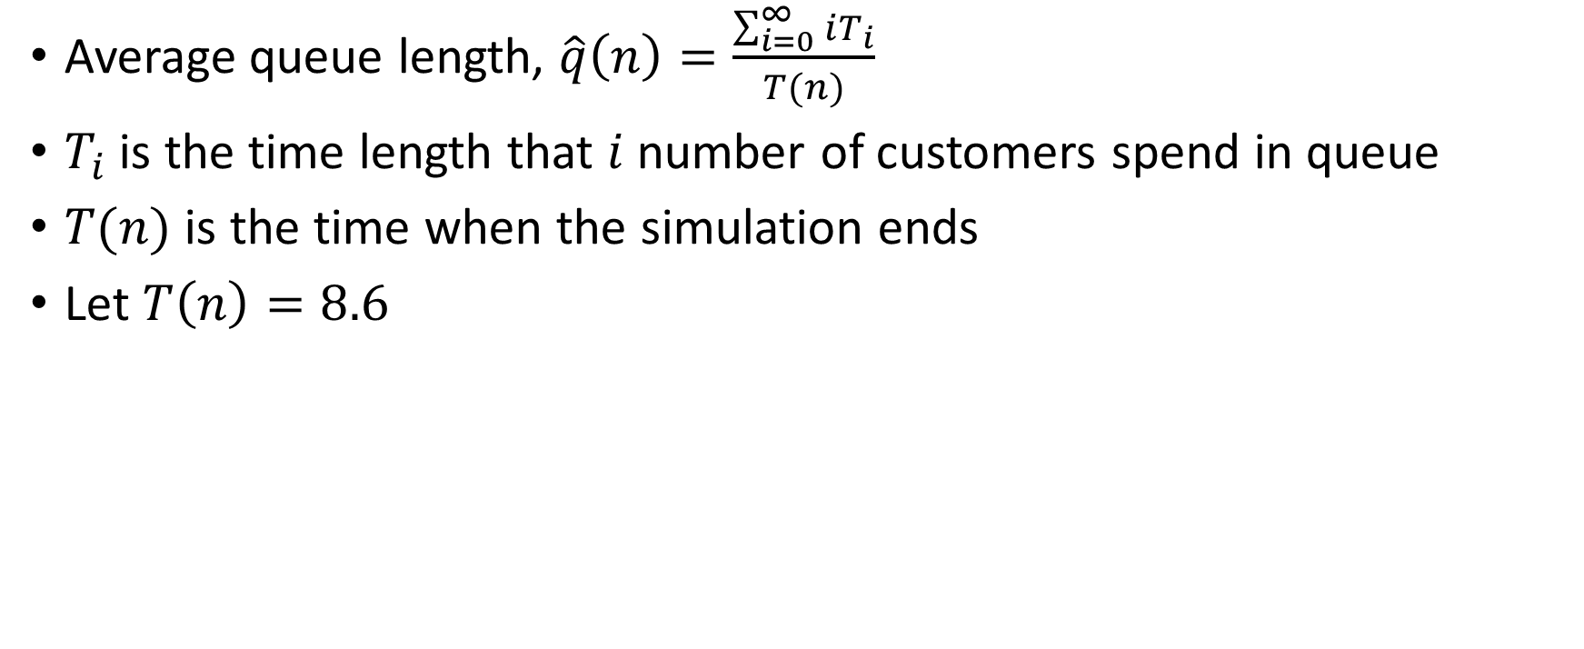
Calculation of Average Queue Length
Average queue length, $\hat{q}\left(n\right)=\frac{\sum_{i=0}^{∞}{iT_{i}}}{T(n)}$
$T_{i}$ is the time length that $i$ number of customers spend in queue
$T(n)$ is the time when the simulation ends
Let $T\left(n\right)=8.6$

Slide 105

Simulation starts…
3
Customer in queue
2
1
0
1
2
3
4
5
6
7
8
9
$$e_{0}$$

Slide 106


Customer arrives…
3
Customer in queue
2
1
0
0.4
1
2
3
4
5
6
7
8
9
$$t_{1}$$
$$e_{0}$$
$$e_{1}$$

Slide 107


Customer arrives…
3
Customer in queue
2
1
0
0.4
1
1.6
2
3
4
5
6
7
8
9
$$t_{1}$$
$$t_{2}$$
$$e_{0}$$
$$e_{1}$$
$$e_{2}$$

Slide 108


Customer arrives…
3
Customer in queue
2
1
0
0.4
1
1.6
2
2.1
3
4
5
6
7
8
9
$$t_{1}$$
$$t_{2}$$
$$t_{3}$$
$$e_{0}$$
$$e_{1}$$
$$e_{2}$$
$$e_{3}$$

Slide 109


Customer leaves…
3
Customer in queue
2
1
0
0.4
1
1.6
2
2.1
2.4
3
4
5
6
7
8
9
$$t_{1}$$
$$t_{2}$$
$$t_{3}$$
$$c_{1}$$
$$e_{0}$$
$$e_{1}$$
$$e_{2}$$
$$e_{3}$$
$$e_{4}$$

Slide 110


Customer leaves…
3
Customer in queue
2
1
0
0.4
1
1.6
2
2.1
2.4
3
4
5
6
7
8
9
3.1
$$t_{1}$$
$$t_{2}$$
$$t_{3}$$
$$c_{1}$$
$$c_{2}$$
$$e_{0}$$
$$e_{1}$$
$$e_{2}$$
$$e_{3}$$
$$e_{4}$$
$$e_{5}$$

Slide 111


Customer leaves…
3
Customer in queue
2
1
0
0.4
1
1.6
2
2.1
2.4
3
4
5
6
7
8
9
3.1
3.3
$$t_{1}$$
$$t_{2}$$
$$t_{3}$$
$$c_{1}$$
$$c_{2}$$
$$c_{3}$$
$$e_{0}$$
$$e_{1}$$
$$e_{2}$$
$$e_{3}$$
$$e_{4}$$
$$e_{5}$$
$$e_{6}$$

Slide 112


Customer arrives…
3
Customer in queue
2
1
0
0.4
1
1.6
2
2.1
2.4
3
4
5
6
7
8
9
3.1
3.3
3.8
$$t_{1}$$
$$t_{2}$$
$$t_{3}$$
$$c_{1}$$
$$c_{2}$$
$$c_{3}$$
$$t_{4}$$
$$e_{0}$$
$$e_{1}$$
$$e_{2}$$
$$e_{3}$$
$$e_{4}$$
$$e_{5}$$
$$e_{6}$$
$$e_{7}$$

Slide 113


Customer arrives…
3
Customer in queue
2
1
0
0.4
1
1.6
2
2.1
2.4
3
4
5
6
7
8
9
3.1
3.3
3.8
$$t_{1}$$
$$t_{2}$$
$$t_{3}$$
$$c_{1}$$
$$c_{2}$$
$$c_{3}$$
$$t_{5}$$
$$t_{4}$$
$$e_{0}$$
$$e_{1}$$
$$e_{2}$$
$$e_{3}$$
$$e_{4}$$
$$e_{5}$$
$$e_{6}$$
$$e_{7}$$
$$e_{8}$$

Slide 114


Customer leaves…
3
Customer in queue
2
1
0
0.4
1
1.6
2
2.1
2.4
3
4
4.9
5
6
7
8
9
3.1
3.3
3.8
$$t_{1}$$
$$t_{2}$$
$$t_{3}$$
$$c_{1}$$
$$c_{2}$$
$$c_{3}$$
$$t_{5}$$
$$t_{4}$$
$$c_{4}$$
$$e_{0}$$
$$e_{1}$$
$$e_{2}$$
$$e_{3}$$
$$e_{4}$$
$$e_{5}$$
$$e_{6}$$
$$e_{7}$$
$$e_{8}$$
$$e_{9}$$

Slide 115


Customer arrives…
3
Customer in queue
2
1
0
0.4
1
1.6
2
2.1
2.4
3
4
4.9
5
5.6
6
7
8
9
3.1
3.3
3.8
$$t_{1}$$
$$t_{2}$$
$$t_{3}$$
$$c_{1}$$
$$c_{2}$$
$$c_{3}$$
$$t_{5}$$
$$t_{6}$$
$$t_{4}$$
$$c_{4}$$
$$e_{0}$$
$$e_{1}$$
$$e_{2}$$
$$e_{3}$$
$$e_{4}$$
$$e_{5}$$
$$e_{6}$$
$$e_{7}$$
$$e_{8}$$
$$e_{9}$$
$$e_{10}$$

Slide 116


Customer arrives…
3
Customer in queue
2
1
0
0.4
1
1.6
2
2.1
2.4
3
4
4.9
5
5.6
5.8
6
7
8
9
3.1
3.3
3.8
$$t_{1}$$
$$t_{2}$$
$$t_{3}$$
$$c_{1}$$
$$c_{2}$$
$$c_{3}$$
$$t_{5}$$
$$t_{6}$$
$$t_{7}$$
$$t_{4}$$
$$c_{4}$$
$$e_{0}$$
$$e_{1}$$
$$e_{2}$$
$$e_{3}$$
$$e_{4}$$
$$e_{5}$$
$$e_{6}$$
$$e_{7}$$
$$e_{8}$$
$$e_{9}$$
$$e_{10}$$
$$e_{11}$$

Slide 117


Customer arrives…
3
Customer in queue
2
1
0
0.4
1
1.6
2
2.1
2.4
3
4
4.9
5
5.6
5.8
6
7
7.2
8
9
3.1
3.3
3.8
$$t_{1}$$
$$t_{2}$$
$$t_{3}$$
$$c_{1}$$
$$c_{2}$$
$$c_{3}$$
$$t_{5}$$
$$t_{6}$$
$$t_{7}$$
$$t_{4}$$
$$c_{4}$$
$$t_{8}$$
$$e_{0}$$
$$e_{1}$$
$$e_{2}$$
$$e_{3}$$
$$e_{4}$$
$$e_{5}$$
$$e_{6}$$
$$e_{7}$$
$$e_{8}$$
$$e_{9}$$
$$e_{10}$$
$$e_{11}$$
$$e_{12}$$

Slide 118


Customer leaves…
3
Customer in queue
2
1
0
0.4
1
1.6
2
2.1
2.4
3
4
4.9
5
5.6
5.8
6
7
7.2
8
8.6
9
3.1
3.3
3.8
$$t_{1}$$
$$t_{2}$$
$$t_{3}$$
$$c_{1}$$
$$c_{2}$$
$$c_{3}$$
$$t_{5}$$
$$t_{6}$$
$$t_{7}$$
$$t_{4}$$
$$c_{4}$$
$$t_{8}$$
$$c_{5}$$
$$e_{0}$$
$$e_{1}$$
$$e_{2}$$
$$e_{3}$$
$$e_{4}$$
$$e_{5}$$
$$e_{6}$$
$$e_{7}$$
$$e_{8}$$
$$e_{9}$$
$$e_{10}$$
$$e_{11}$$
$$e_{12}$$
$$e_{13}$$

Slide 119




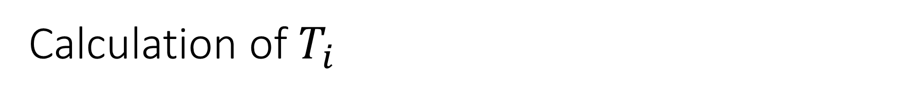






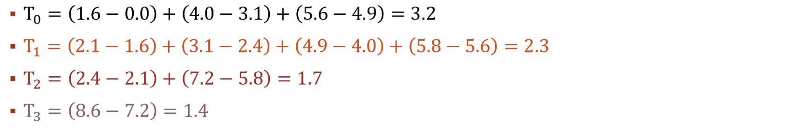
Calculation of $T_{i}$
$$T_{3}$$
3
Customer in queue
$$T_{2}$$
$$T_{2}$$
2
$$T_{1}$$
$$T_{1}$$
$$T_{1}$$
$$T_{1}$$
1
$$T_{0}$$
$$T_{0}$$
$$T_{0}$$
0
0.4
1
1.6
2
2.1
2.4
3
4
4.9
5
5.6
5.8
6
7
7.2
8
8.6
9
3.1
3.3
3.8
$$t_{1}$$
$$t_{2}$$
$$t_{3}$$
$$c_{1}$$
$$c_{2}$$
$$c_{3}$$
$$t_{5}$$
$$t_{6}$$
$$t_{7}$$
$$t_{4}$$
$$c_{4}$$
$$t_{8}$$
$$c_{5}$$
$$e_{0}$$
$$e_{1}$$
$$e_{2}$$
$$e_{3}$$
$$e_{4}$$
$$e_{5}$$
$$e_{6}$$
$$e_{7}$$
$$e_{8}$$
$$e_{9}$$
$$e_{10}$$
$$e_{11}$$
$$e_{12}$$
$$e_{13}$$
$T_{0}=\left(1.6−0.0\right)+\left(4.0−3.1\right)+\left(5.6−4.9\right)=3.2$
$T_{1}=\left(2.1−1.6\right)+\left(3.1−2.4\right)+\left(4.9−4.0\right)+\left(5.8−5.6\right)=2.3$
$T_{2}=\left(2.4−2.1\right)+\left(7.2−5.8\right)=1.7$
$T_{3}=\left(8.6−7.2\right)=1.4$

Slide 120
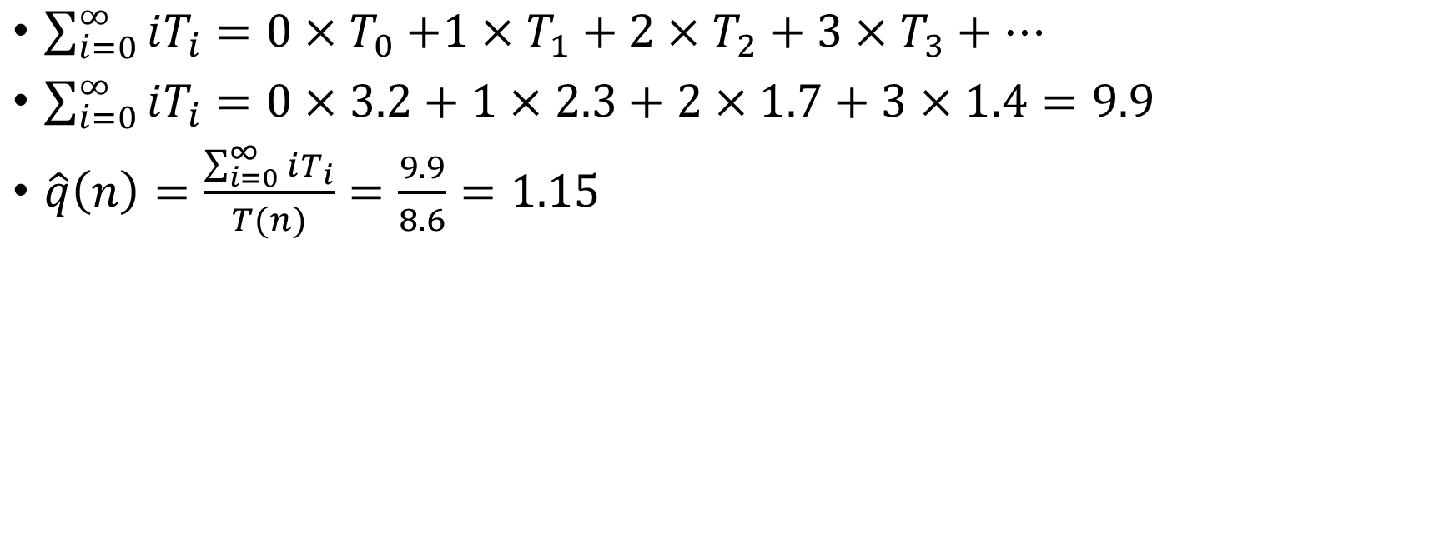
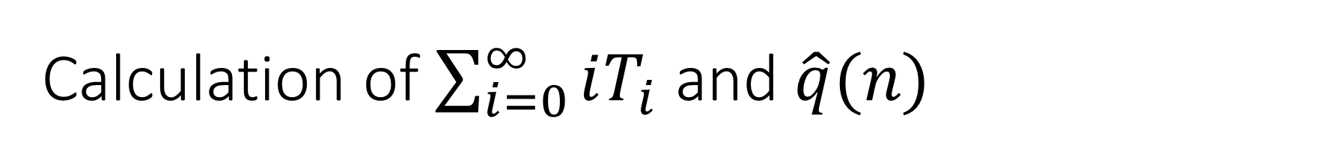
Calculation of $\sum_{i=0}^{∞}{iT_{i}}$ and $\hat{q}(n)$
$\sum_{i=0}^{∞}{iT_{i}=0{×T}_{0}+1×T_{1}+2×T_{2}+3×T_{3}+…}$
$\sum_{i=0}^{∞}{iT_{i}=0×3.2+1×2.3+2×1.7+3×1.4=9.9}$
$\hat{q}\left(n\right)=\frac{\sum_{i=0}^{∞}{iT_{i}}}{T(n)}=\frac{9.9}{8.6}=1.15$

Slide 121
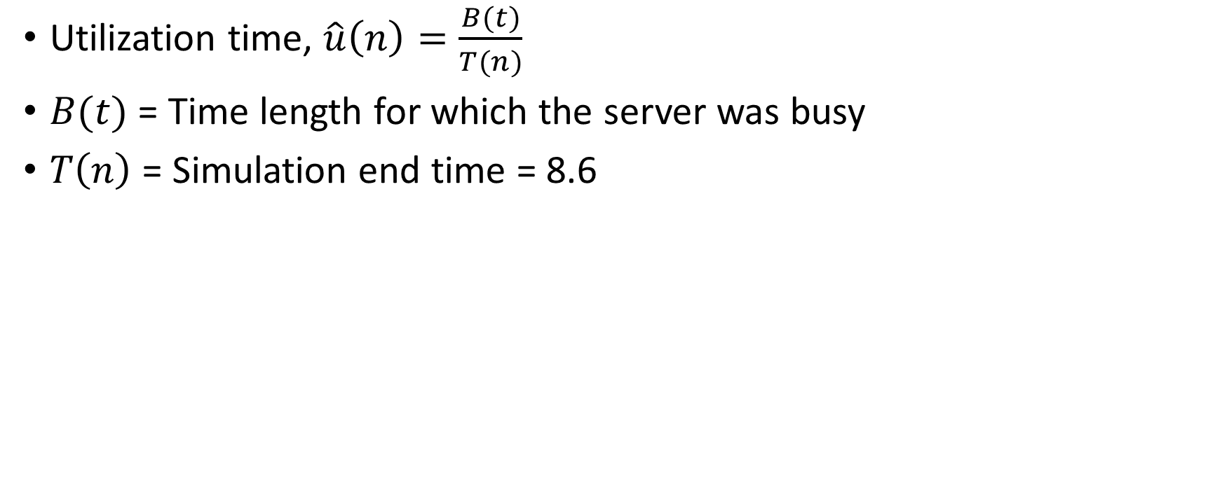
Calculation of Utilization Time
Utilization time, $\hat{u}\left(n\right)=\frac{B(t)}{T(n)}$
$B(t)$ = Time length for which the server was busy
$T\left(n\right)$ = Simulation end time = 8.6

Slide 122
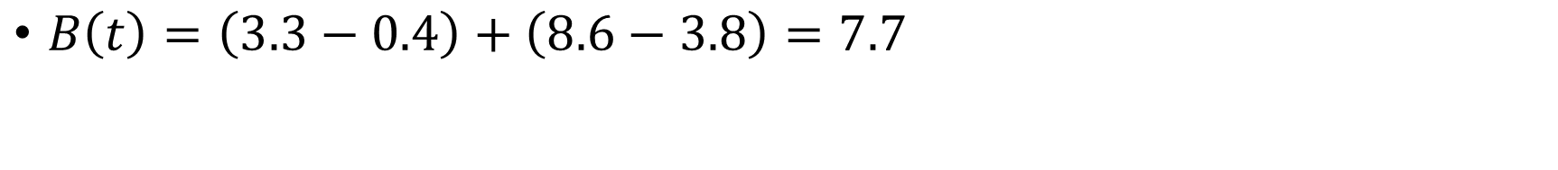
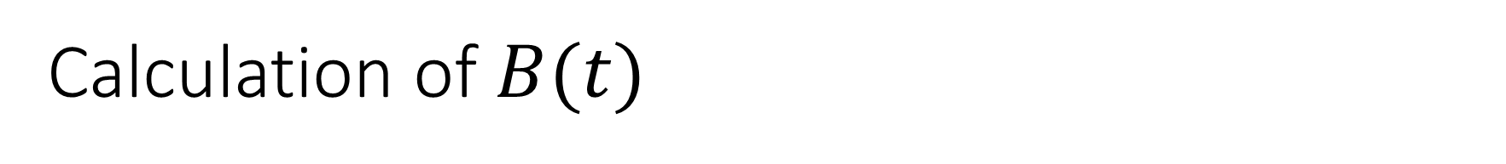


Calculation of $B(t)$
$$B(t)$$
3
$$B(t)$$
Customer in queue
2
1
0
0.4
1
1.6
2
2.1
2.4
3
4
4.9
5
5.6
5.8
6
7
7.2
8
8.6
9
3.1
3.3
3.8
$$t_{1}$$
$$t_{2}$$
$$t_{3}$$
$$c_{1}$$
$$c_{2}$$
$$c_{3}$$
$$t_{5}$$
$$t_{6}$$
$$t_{7}$$
$$t_{4}$$
$$c_{4}$$
$$t_{8}$$
$$c_{5}$$
$$e_{0}$$
$$e_{1}$$
$$e_{2}$$
$$e_{3}$$
$$e_{4}$$
$$e_{5}$$
$$e_{6}$$
$$e_{7}$$
$$e_{8}$$
$$e_{9}$$
$$e_{10}$$
$$e_{11}$$
$$e_{12}$$
$$e_{13}$$
$B\left(t\right)=\left(3.3−0.4\right)+\left(8.6−3.8\right)=7.7$

Slide 123
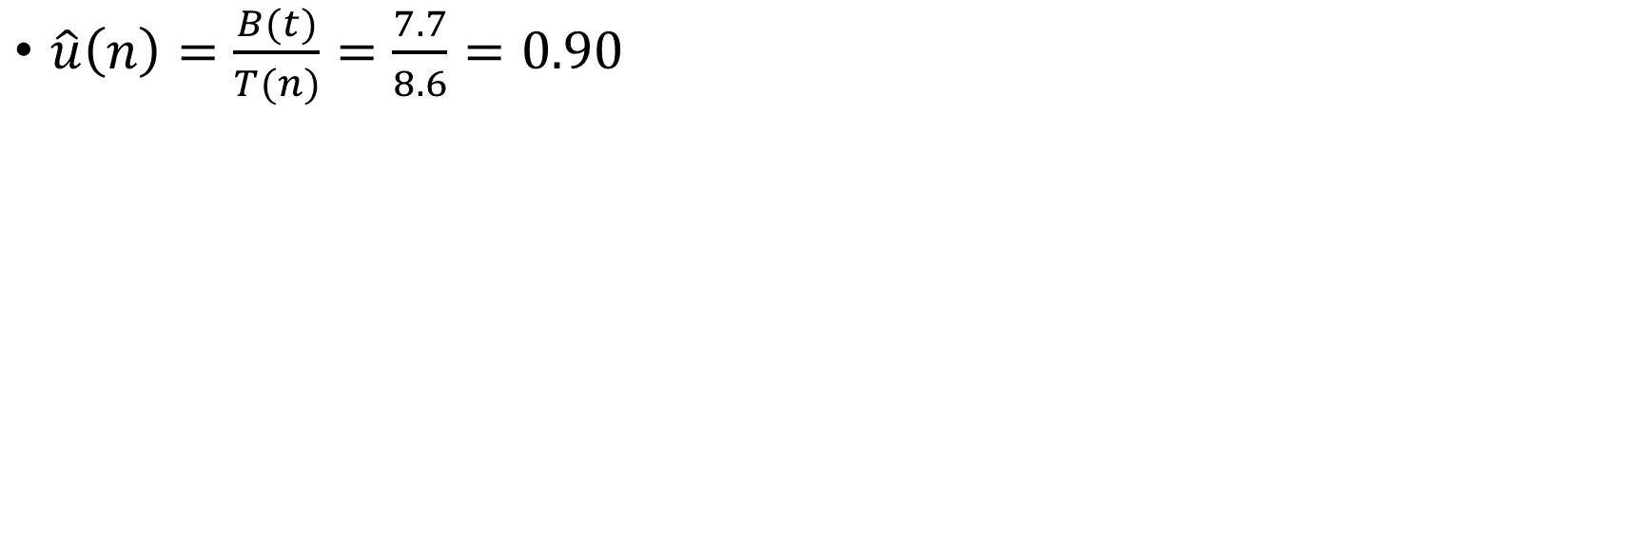
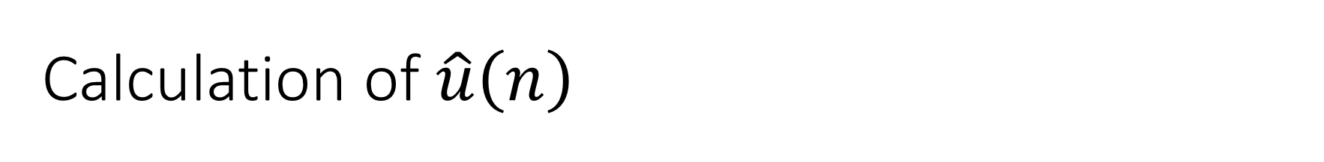
Calculation of $\hat{u}\left(n\right)$
$\hat{u}\left(n\right)=\frac{B(t)}{T(n)}=\frac{7.7}{8.6}=0.90$

Slide 124
Week 10
Slides 124-130

Slide 125
Simulation of inventory system

Slide 126
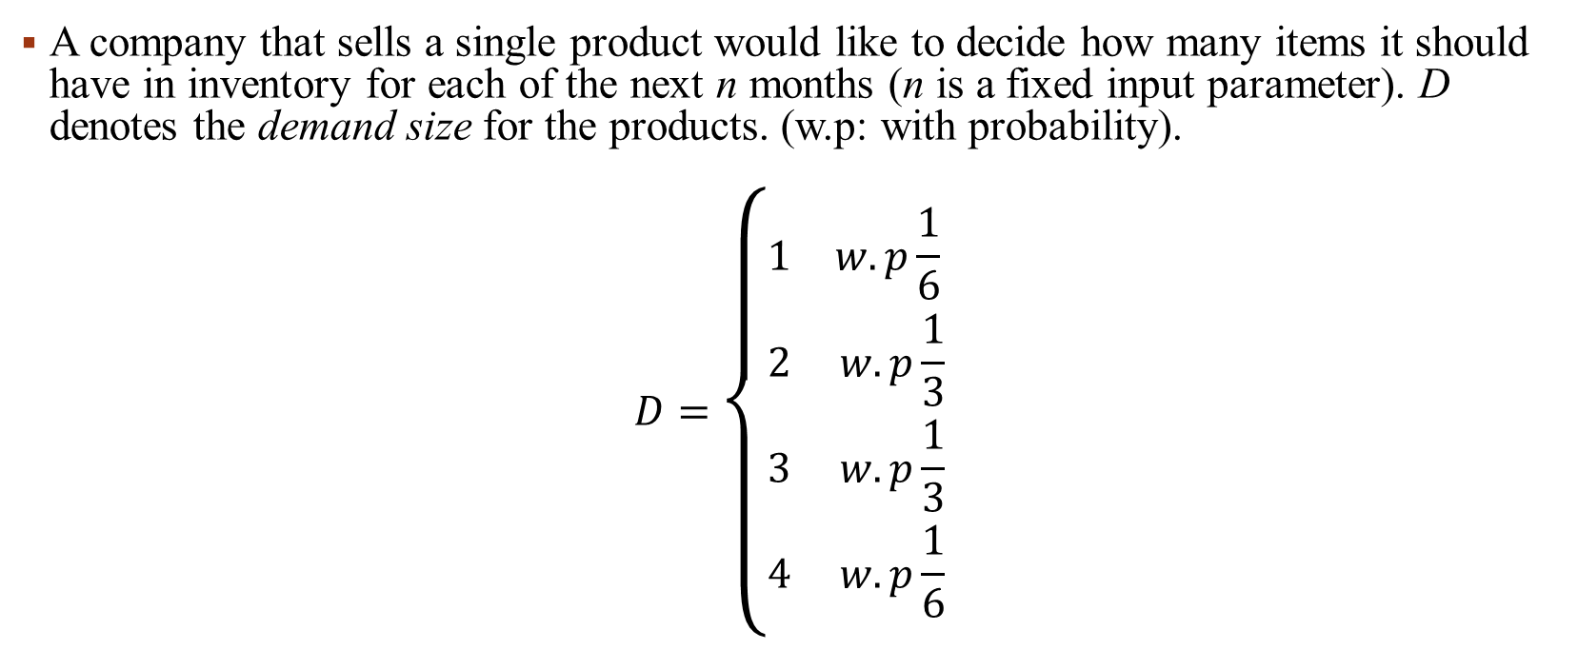
Simulation of inventory system
A company that sells a single product would like to decide how many items it should have in inventory for each of the next n months (n is a fixed input parameter). D denotes the demand size for the products. (w.p: with probability).
$$D=\left\{\begin{matrix}1 & w.p\frac{1}{6} \\ 2 & w.p\frac{1}{3} \\ 3 & w.p\frac{1}{3} \\ 4 & w.p\frac{1}{6}\end{matrix}\right.$$

Slide 127
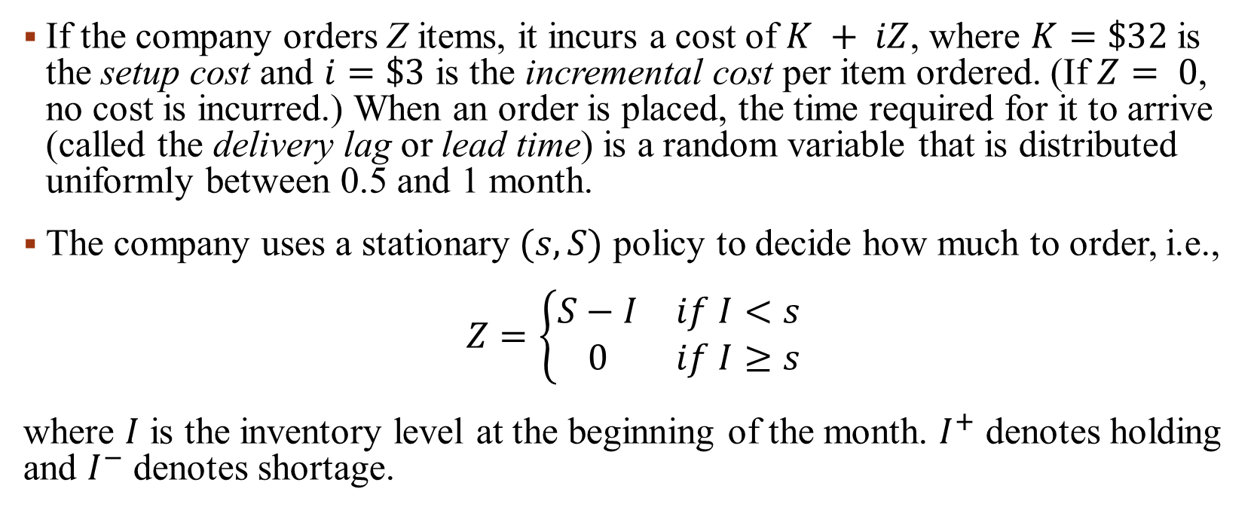
Simulation of inventory system
If the company orders Z items, it incurs a cost of $K + iZ$, where $K=\$32$ is the setup cost and $i=\$3$ is the incremental cost per item ordered. (If $Z= 0$, no cost is incurred.) When an order is placed, the time required for it to arrive (called the delivery lag or lead time) is a random variable that is distributed uniformly between 0.5 and 1 month.
The company uses a stationary $(s, S)$ policy to decide how much to order, i.e.,
$$Z=\left\{\begin{matrix}S−I & if I<s \\ 0 & if I≥s\end{matrix}\right.$$
where $I$ is the inventory level at the beginning of the month. $I^{+}$ denotes holding and $I^{−}$ denotes shortage.

Slide 128
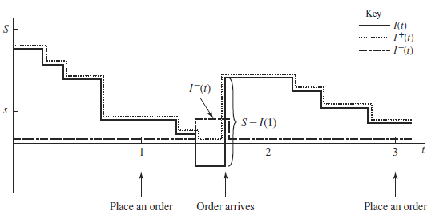
When a demand occurs, it is satisfied immediately if the inventory level is at least as large as the demand. If the demand exceeds the inventory level, the excess of demand over supply is backlogged and satisfied by future deliveries. (In this case, the new inventory level is equal to the old inventory level minus the demand size, resulting in a negative inventory level.) When an order arrives, it is first used to eliminate as much of the backlog (if any) as possible; the remainder of the order (if any) is added to the inventory.

Slide 129
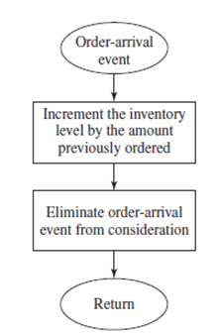
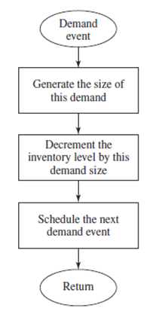
Flowchart for Order Arrival and Demand

Slide 130
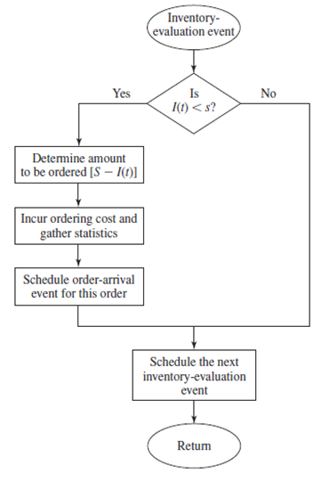
Flowchart for Inventory Evaluation

Slide 131
Week 11
Slides 131-139

Slide 132
Random Variables

Slide 133
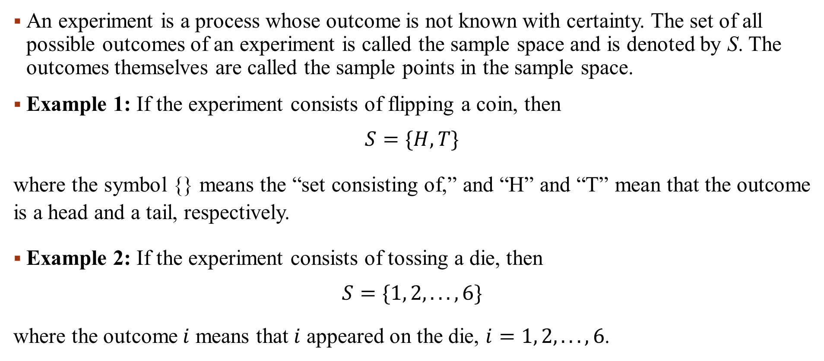
Experiment, Sample Space, Sample Points
An experiment is a process whose outcome is not known with certainty. The set of all possible outcomes of an experiment is called the sample space and is denoted by S. The outcomes themselves are called the sample points in the sample space.
Example 1: If the experiment consists of flipping a coin, then
$$S=\{H, T\}$$
where the symbol {} means the “set consisting of,” and “H” and “T” mean that the outcome is a head and a tail, respectively.
Example 2: If the experiment consists of tossing a die, then
$$S=\{1, 2, . . . , 6\}$$
where the outcome $i$ means that $i$ appeared on the die, $i=1, 2, . . . , 6$.

Slide 134
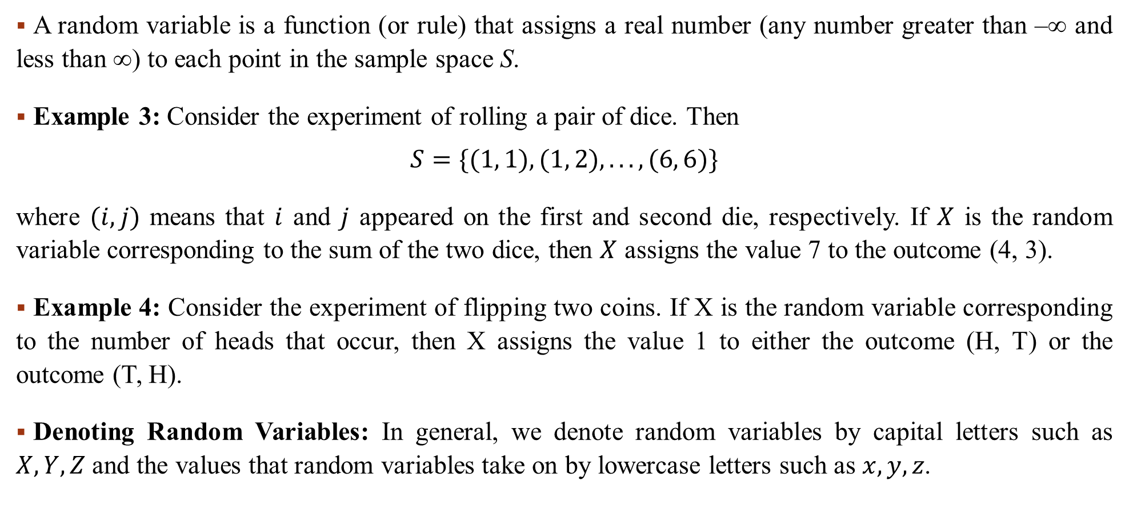
Random Variable
A random variable is a function (or rule) that assigns a real number (any number greater than –∞ and less than ∞) to each point in the sample space S.
Example 3: Consider the experiment of rolling a pair of dice. Then
$$S=\{(1, 1), (1, 2), . . . , (6, 6)\}$$
where $(i, j)$ means that $i$ and $j$ appeared on the first and second die, respectively. If $X$ is the random variable corresponding to the sum of the two dice, then $X$ assigns the value 7 to the outcome (4, 3).
Example 4: Consider the experiment of flipping two coins. If X is the random variable corresponding to the number of heads that occur, then X assigns the value 1 to either the outcome (H, T) or the outcome (T, H).
Denoting Random Variables: In general, we denote random variables by capital letters such as $X, Y, Z$ and the values that random variables take on by lowercase letters such as $x, y, z$.

Slide 135
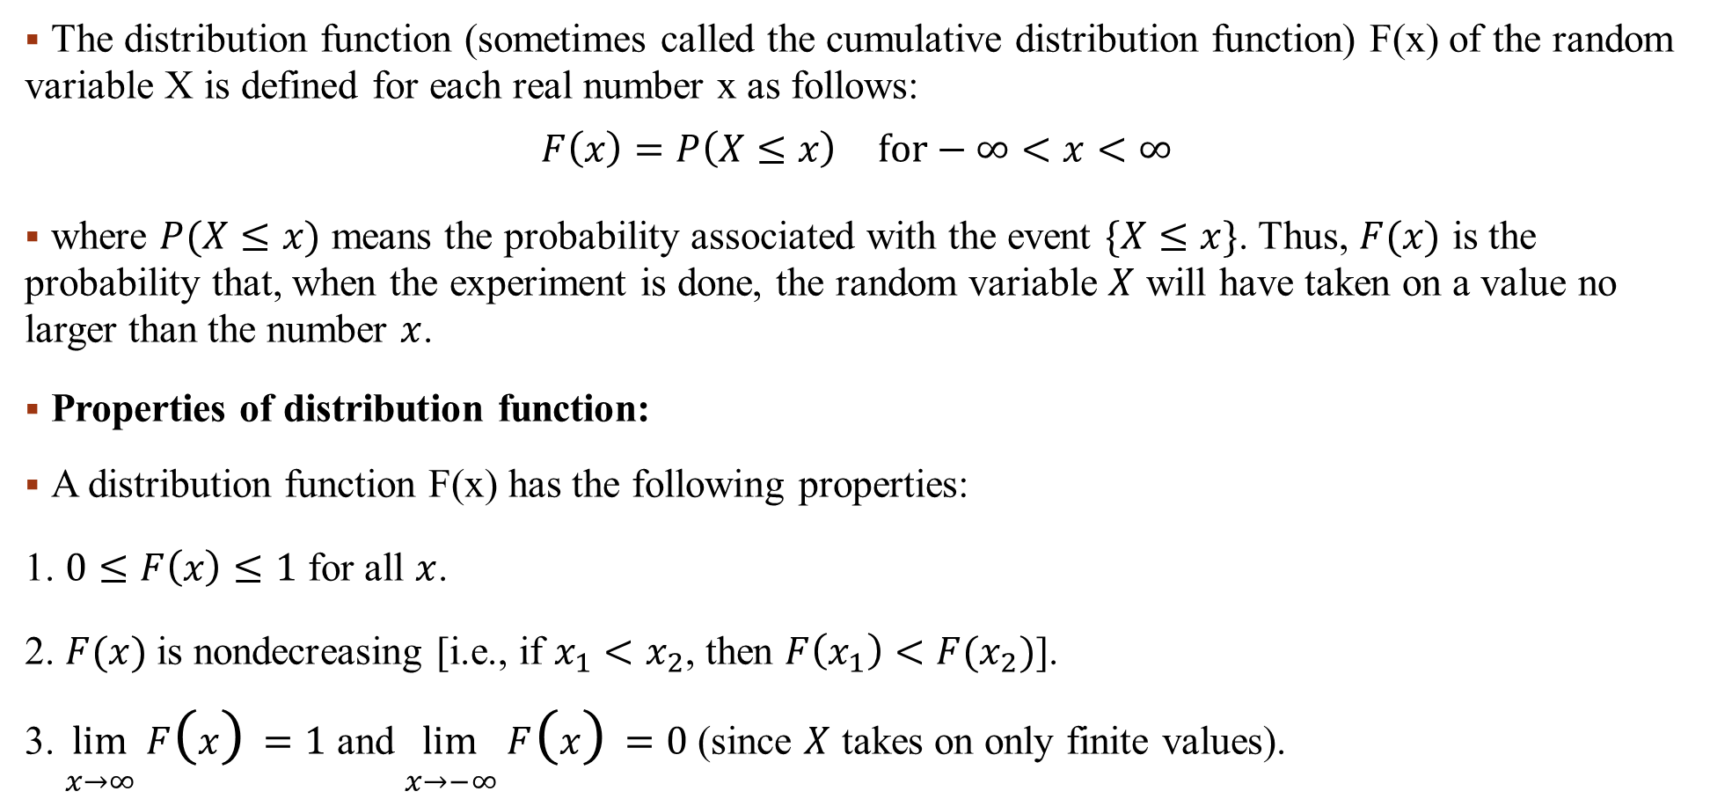
Distribution Function
The distribution function (sometimes called the cumulative distribution function) F(x) of the random variable X is defined for each real number x as follows:
$$F\left(x\right)=\begin{matrix}P\left(X≤x\right) & \text{for}−∞<x<∞\end{matrix}$$
where $P(X≤x)$ means the probability associated with the event $\{X≤x\}$. Thus, $F(x)$ is the probability that, when the experiment is done, the random variable $X$ will have taken on a value no larger than the number $x$.
Properties of distribution function:
A distribution function F(x) has the following properties:
1. $0≤F\left(x\right)≤1$ for all $x$.
2. $F(x)$is nondecreasing [i.e., if $x_{1}<x_{2}$, then $F\left(x_{1}\right)<F(x_{2})$].
3. $\lim_{x→∞}{F\left(x\right)=1}$ and $\lim_{x→−∞}{F\left(x\right)=0}$ (since $X$ takes on only finite values).

Slide 136
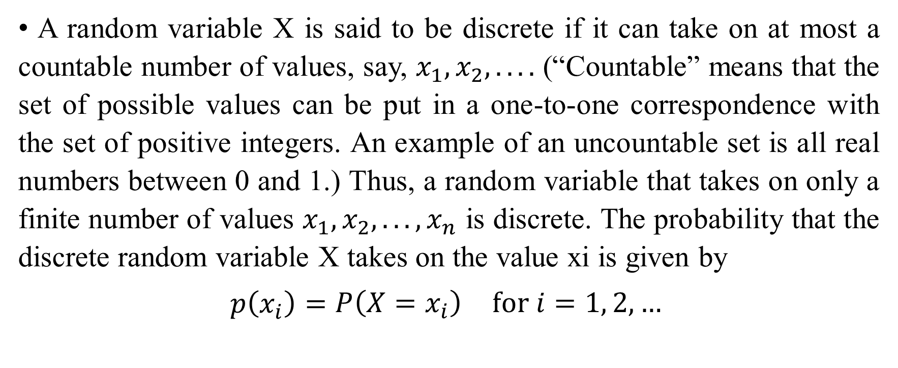
Discrete Random Variables
A random variable X is said to be discrete if it can take on at most a countable number of values, say, $x_{1}, x_{2}, . . . .$ (“Countable” means that the set of possible values can be put in a one-to-one correspondence with the set of positive integers. An example of an uncountable set is all real numbers between 0 and 1.) Thus, a random variable that takes on only a finite number of values $x_{1}, x_{2}, . . . , x_{n}$ is discrete. The probability that the discrete random variable X takes on the value xi is given by
$$p\left(x_{i}\right)=\begin{matrix}P\left(X=x_{i}\right) & \text{for} i=1, 2, …\end{matrix}$$

Slide 137
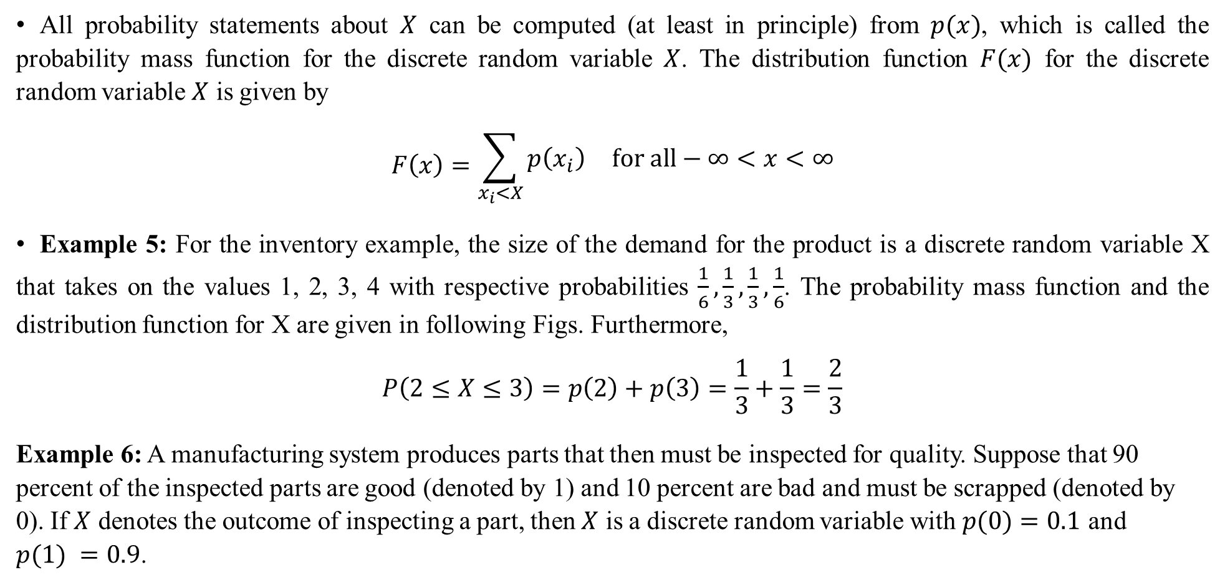
Probability Mass Function
All probability statements about $X$ can be computed (at least in principle) from $p(x)$, which is called the probability mass function for the discrete random variable $X$. The distribution function $F(x)$ for the discrete random variable $X$ is given by
$$F\left(x\right)=\begin{matrix}\sum_{x_{i}<X}{p\left(x_{i}\right)} & \text{for} \text{all}−∞<x<∞\end{matrix}$$
Example 5: For the inventory example, the size of the demand for the product is a discrete random variable X that takes on the values 1, 2, 3, 4 with respective probabilities $\frac{1}{6},\frac{1}{3},\frac{1}{3},\frac{1}{6}$. The probability mass function and the distribution function for X are given in following Figs. Furthermore,
$$P\left(2≤X≤3\right)=p\left(2\right)+p\left(3\right)=\frac{1}{3}+\frac{1}{3}=\frac{2}{3}$$
Example 6: A manufacturing system produces parts that then must be inspected for quality. Suppose that 90 percent of the inspected parts are good (denoted by 1) and 10 percent are bad and must be scrapped (denoted by 0). If $X$ denotes the outcome of inspecting a part, then $X$ is a discrete random variable with $p(0)=0.1$ and $p(1) =0.9$.

Slide 138
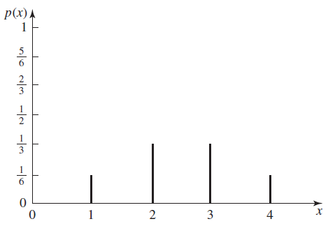
p(x) for the demand-size random variable X

Slide 139
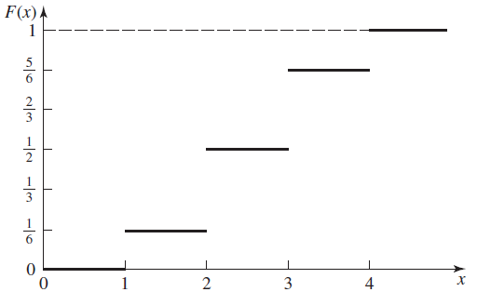
F(x) for the demand-size random variable

Slide 140
Week 12
Slides 140-145

Slide 141
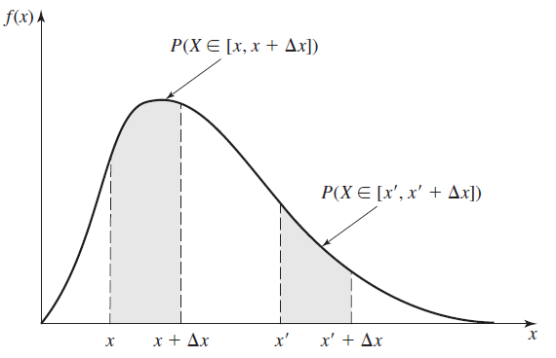
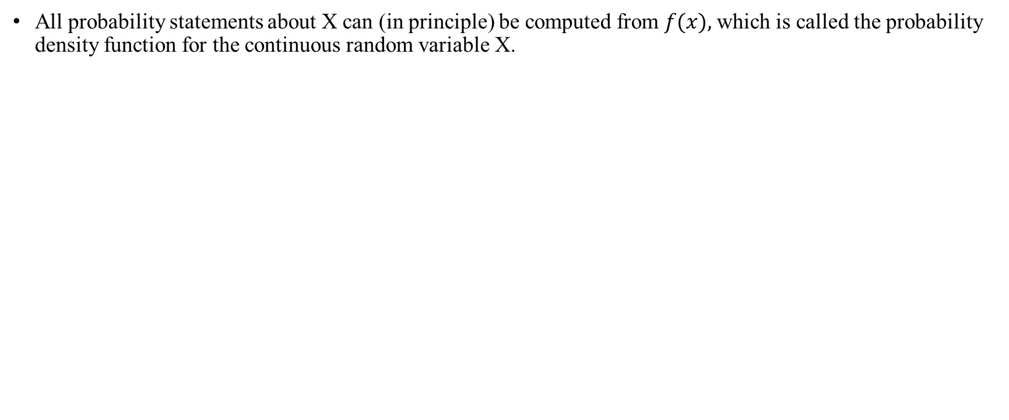
Probability Density Function
All probability statements about X can (in principle) be computed from $f(x),$which is called the probability density function for the continuous random variable X.

Slide 142
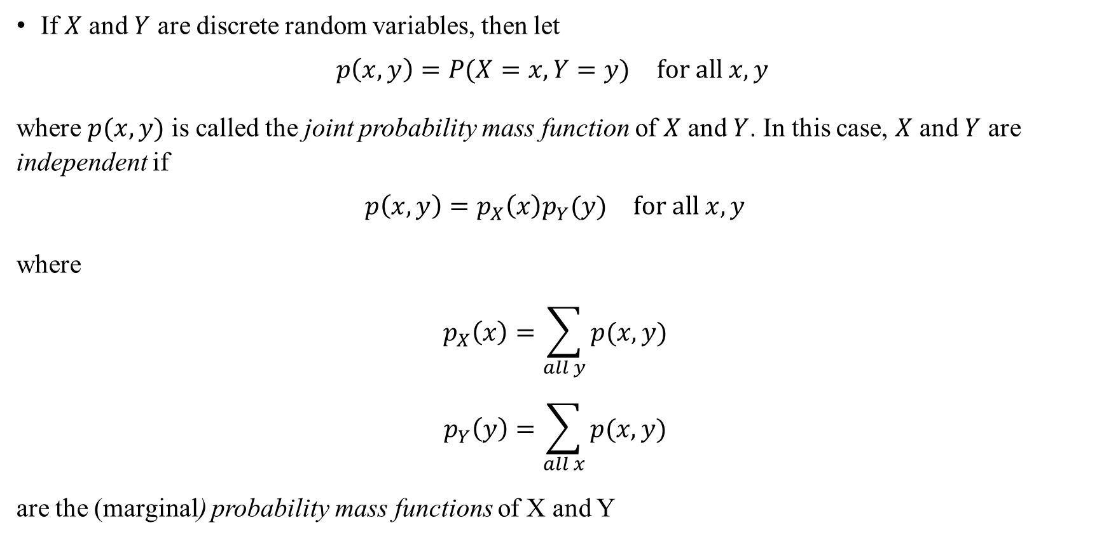
Joint Probability Mass Function
If $X$ and $Y$ are discrete random variables, then let
$$\begin{matrix}p\left(x, y\right)=P(X=x, Y=y) & \text{for} \text{all} x, y\end{matrix}$$
where $p(x, y)$ is called the joint probability mass function of $X$ and $Y$. In this case, $X$ and $Y$ are independent if
$$\begin{matrix}p\left(x, y\right)=p_{X}\left(x\right)p_{Y}(y) & \text{for} \text{all} x, y\end{matrix}$$
where
$$p_{X}\left(x\right)=\sum_{all y}{p(x,y)}$$
$$p_{Y}\left(y\right)=\sum_{all x}{p(x,y)}$$
are the (marginal) probability mass functions of X and Y

Slide 143
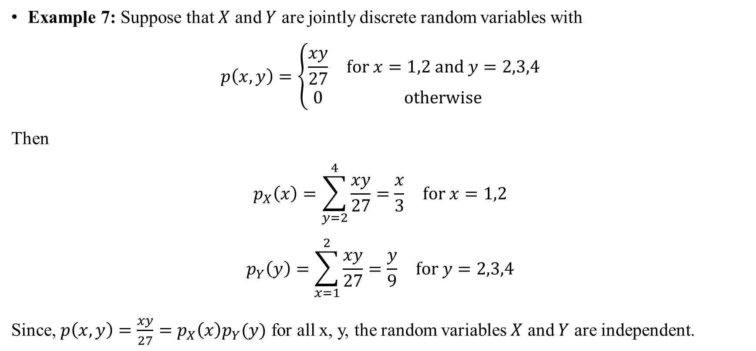
Joint Probability Mass Function
Example 7: Suppose that $X$ and $Y$ are jointly discrete random variables with
$$p\left(x,y\right)=\left\{\begin{matrix}\frac{xy}{27} & \text{for} x=1,2 \text{and} y=2,3,4 \\ 0 & \text{otherwise}\end{matrix}\right.$$
Then
$$p_{X}\left(x\right)=\sum_{y=2}^{4}{\begin{matrix}\frac{xy}{27}=\frac{x}{3} & \text{for} x=1,2\end{matrix}}$$
$$p_{Y}\left(y\right)=\sum_{x=1}^{2}{\begin{matrix}\frac{xy}{27}=\frac{y}{9} & \text{for} y=2,3,4\end{matrix}}$$
Since, $p\left(x, y\right)=\frac{xy}{27}=p_{X}\left(x\right)p_{Y}(y)$ for all x, y, the random variables $X$ and $Y$ are independent.

Slide 144
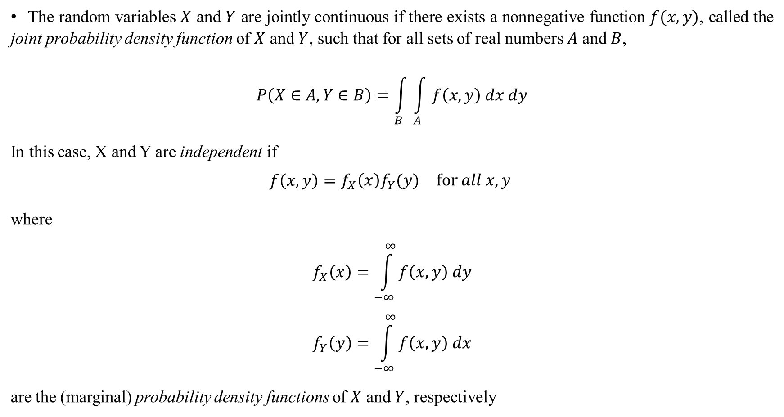
Joint Probability Density Function
The random variables $X$ and $Y$ are jointly continuous if there exists a nonnegative function $f(x, y)$, called the joint probability density function of $X$ and $Y$, such that for all sets of real numbers $A$ and $B$,
$$P\left(X∈A,Y∈B\right)=\int_{B}{\int_{A}{f\left(x,y\right) dx dy}}$$
In this case, X and Y are independent if
$$f\left(x, y\right)=\begin{matrix}f_{X}\left(x\right)f_{Y}(y) & \text{for} all x, y\end{matrix}$$
where
$$f_{X}\left(x\right)=\int_{−∞}^{∞}{f\left(x,y\right) dy}$$
$$f_{Y}\left(y\right)=\int_{−∞}^{∞}{f\left(x,y\right) dx}$$
are the (marginal) probability density functions of $X$ and $Y$, respectively

Slide 145
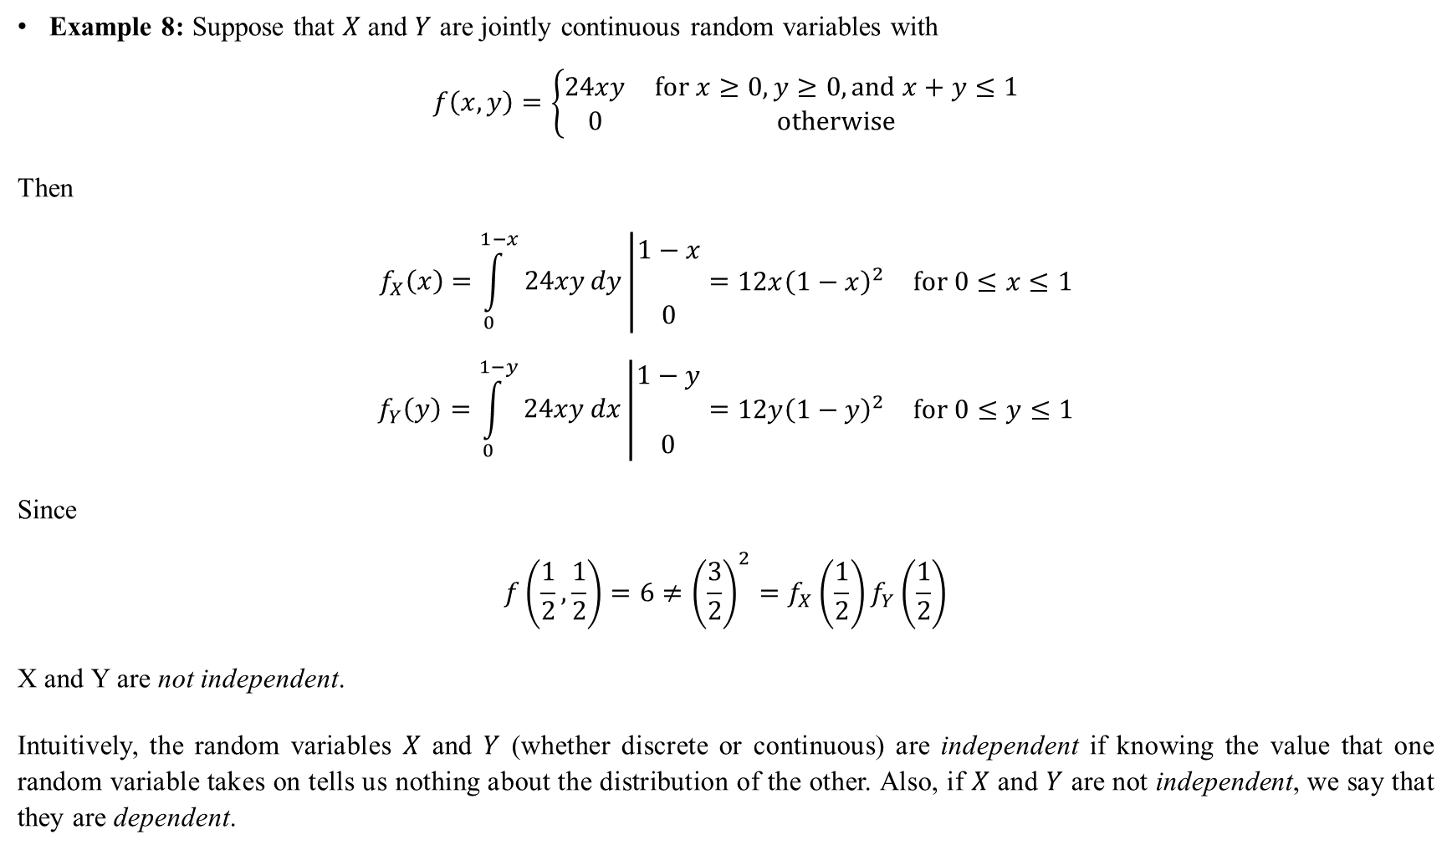
Joint Probability Density Function
Example 8: Suppose that $X$ and $Y$ are jointly continuous random variables with
$$f\left(x,y\right)=\left\{\begin{matrix}24xy & \text{for} x≥0, y≥0, \text{and} x+y≤1 \\ 0 & \text{otherwise}\end{matrix}\right.$$
Then
$$f_{X}\left(x\right)=\int_{0}^{1−x}{24xydy\left|\begin{matrix}1−x \\ \\ 0\end{matrix}=\begin{matrix}12x{\left(1−x\right)}^{2} & \text{for} 0≤x≤1\end{matrix}\right.}$$
$$f_{Y}\left(y\right)=\int_{0}^{1−y}{24xydx\left|\begin{matrix}1−y \\ \\ 0\end{matrix}=\begin{matrix}12y{\left(1−y\right)}^{2} & \text{for} 0≤y≤1\end{matrix}\right.}$$
Since
$$f\left(\frac{1}{2},\frac{1}{2}\right)=6≠{\left(\frac{3}{2}\right)}^{2}=f_{X}\left(\frac{1}{2}\right)f_{Y}\left(\frac{1}{2}\right)$$
X and Y are not independent.
Intuitively, the random variables $X$ and $Y$ (whether discrete or continuous) are independent if knowing the value that one random variable takes on tells us nothing about the distribution of the other. Also, if $X$ and $Y$ are not independent, we say that they are dependent.

Slide 146
Week 14
Slides 146-153

Slide 147
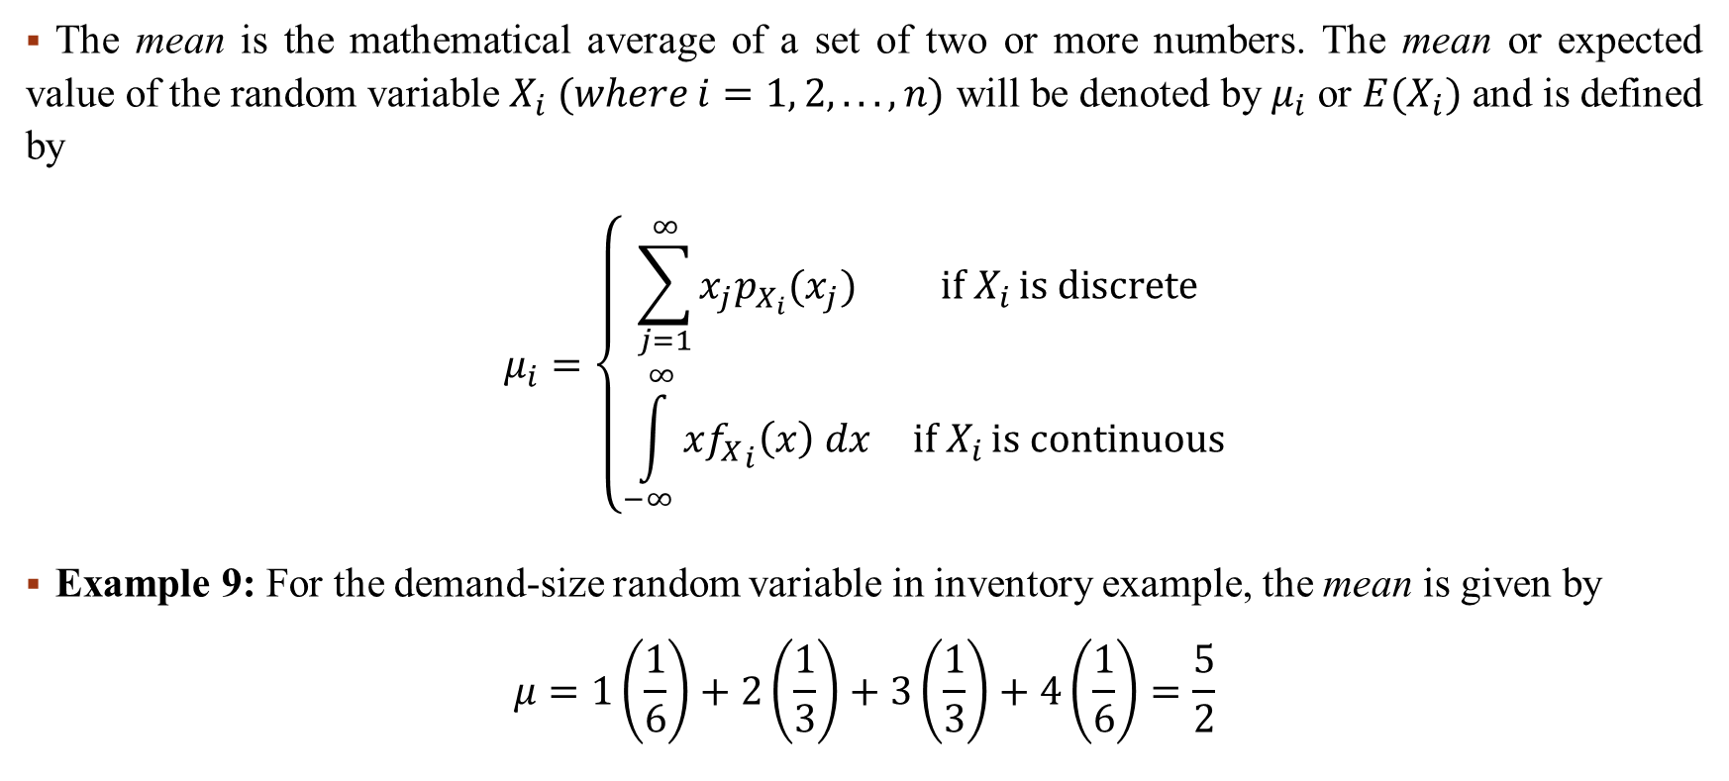
Mean
The mean is the mathematical average of a set of two or more numbers. The mean or expected value of the random variable $X_{i} (where i=1, 2, . . . , n)$ will be denoted by $μ_{i}$ or $E(X_{i})$ and is defined by
$$μ_{i}=\left\{\begin{matrix}\sum_{j=1}^{∞}{x_{j}p_{X_{i}}(x_{j})} & \text{if} X_{i }\text{is} \text{discrete} \\ \int_{−∞}^{∞}{x{f_{X}}_{i}\left(x\right) dx} & \text{if} X_{i }\text{is} \text{continuous}\end{matrix}\right.$$
Example 9: For the demand-size random variable in inventory example, the mean is given by
$$μ=1\left(\frac{1}{6}\right)+2\left(\frac{1}{3}\right)+3\left(\frac{1}{3}\right)+4\left(\frac{1}{6}\right)=\frac{5}{2}$$

Slide 148
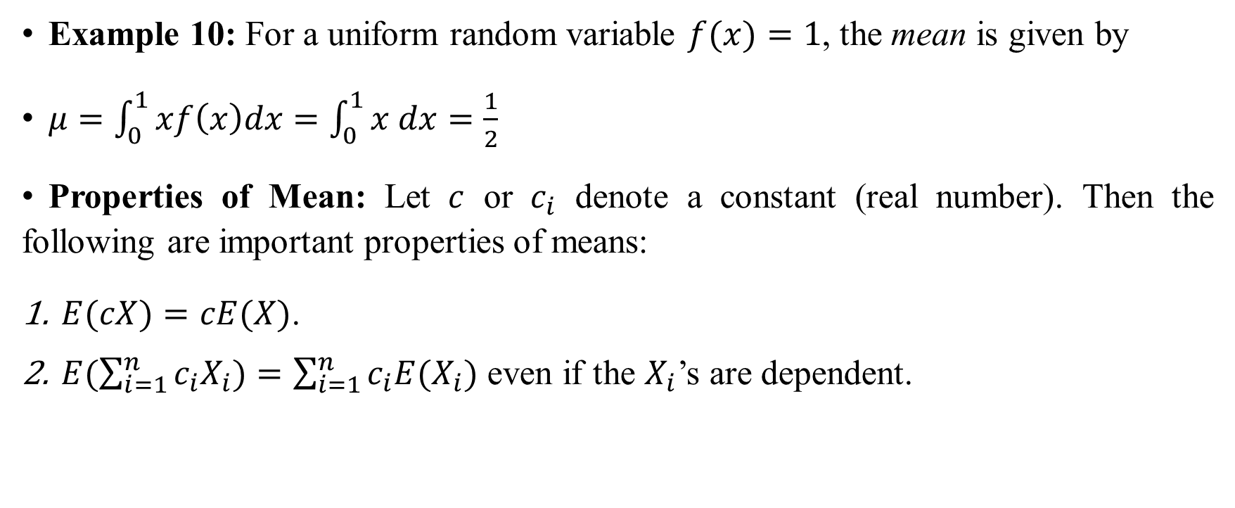
Mean
Example 10: For a uniform random variable $f(x)=1$, the mean is given by
$μ=\int_{0}^{1}{xf\left(x\right)dx}=\int_{0}^{1}{x dx=\frac{1}{2}}$
Properties of Mean: Let $c$ or $c_{i}$ denote a constant (real number). Then the following are important properties of means:
$E(cX)=cE(X)$.
$E(\sum_{i=1}^{n}{c_{i}X_{i})=\sum_{i=1}^{n}{c_{i}E(X_{i})}}$ even if the $X_{i}$’s are dependent.

Slide 149
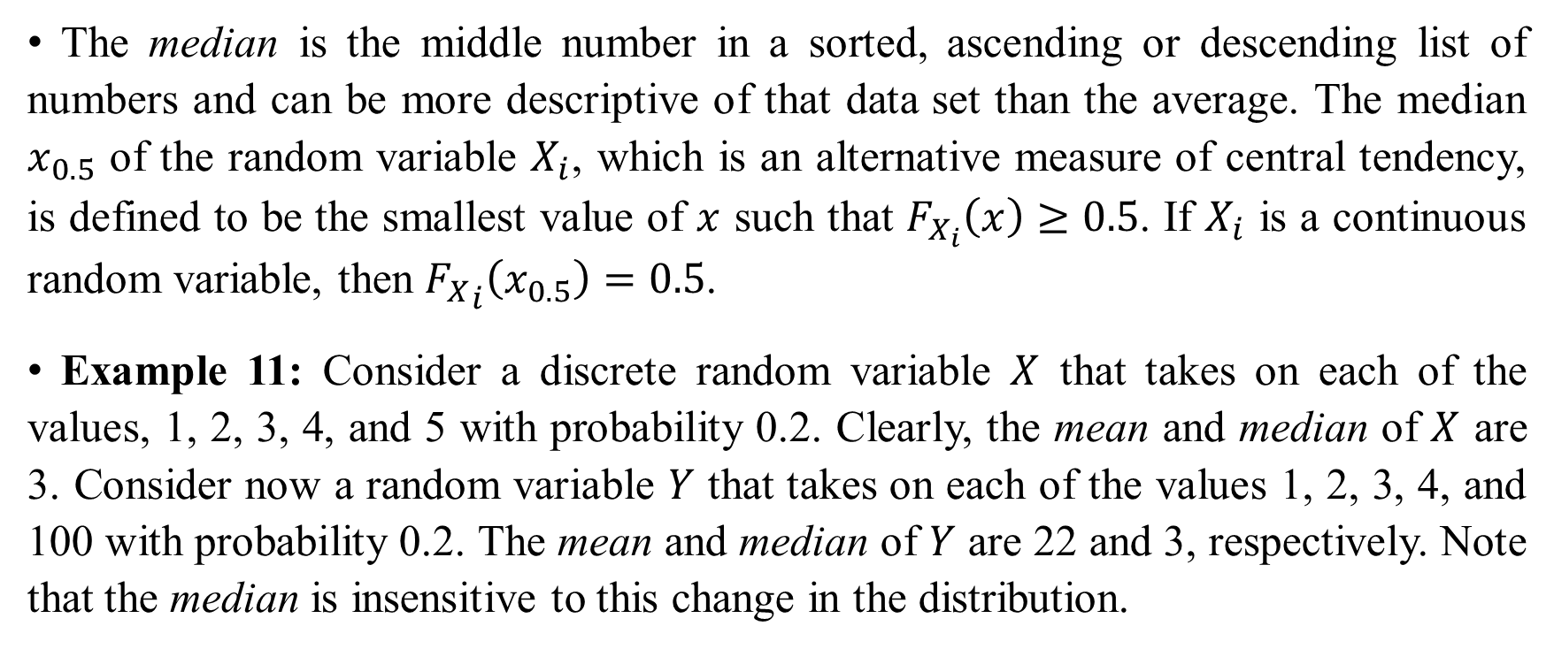
Median
The median is the middle number in a sorted, ascending or descending list of numbers and can be more descriptive of that data set than the average. The median $x_{0.5}$ of the random variable $X_{i}$, which is an alternative measure of central tendency, is defined to be the smallest value of $x$ such that $F_{X_{i}}\left(x\right)≥0.5$. If $X_{i}$ is a continuous random variable, then ${F_{X}}_{i}\left(x_{0.5}\right)=0.5$.
Example 11: Consider a discrete random variable $X$ that takes on each of the values, 1, 2, 3, 4, and 5 with probability 0.2. Clearly, the mean and median of $X$ are 3. Consider now a random variable $Y$ that takes on each of the values 1, 2, 3, 4, and 100 with probability 0.2. The mean and median of $Y$ are 22 and 3, respectively. Note that the median is insensitive to this change in the distribution.

Slide 150
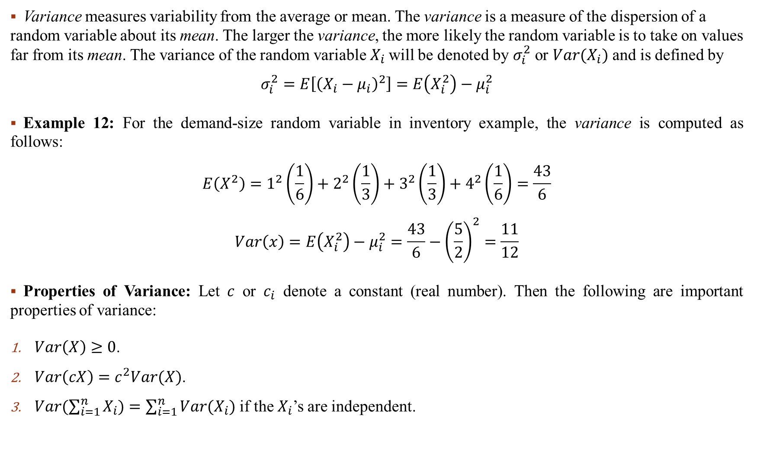
Variance
Variance measures variability from the average or mean. The variance is a measure of the dispersion of a random variable about its mean. The larger the variance, the more likely the random variable is to take on values far from its mean. The variance of the random variable $X_{i}$will be denoted by $σ_{i}^{2}$ or $Var(X_{i})$ and is defined by
$$σ_{i}^{2}=E\left[{\left(X_{i}−μ_{i}\right)}^{2}\right]=E\left(X_{i}^{2}\right)−μ_{i}^{2}$$
Example 12: For the demand-size random variable in inventory example, the variance is computed as follows:
$$E\left(X^{2}\right)=1^{2}\left(\frac{1}{6}\right)+2^{2}\left(\frac{1}{3}\right)+3^{2}\left(\frac{1}{3}\right)+4^{2}\left(\frac{1}{6}\right)=\frac{43}{6}$$
$$Var\left(x\right)=E\left(X_{i}^{2}\right)−μ_{i}^{2}=\frac{43}{6}−{\left(\frac{5}{2}\right)}^{2}=\frac{11}{12}$$
Properties of Variance: Let $c$ or $c_{i}$ denote a constant (real number). Then the following are important properties of variance:
$Var\left(X\right)≥0$.
$Var\left(cX\right)=c^{2}Var(X)$.
$Var(\sum_{i=1}^{n}{X_{i})=\sum_{i=1}^{n}{Var(X_{i})}}$ if the $X_{i}$’s are independent.

Slide 151
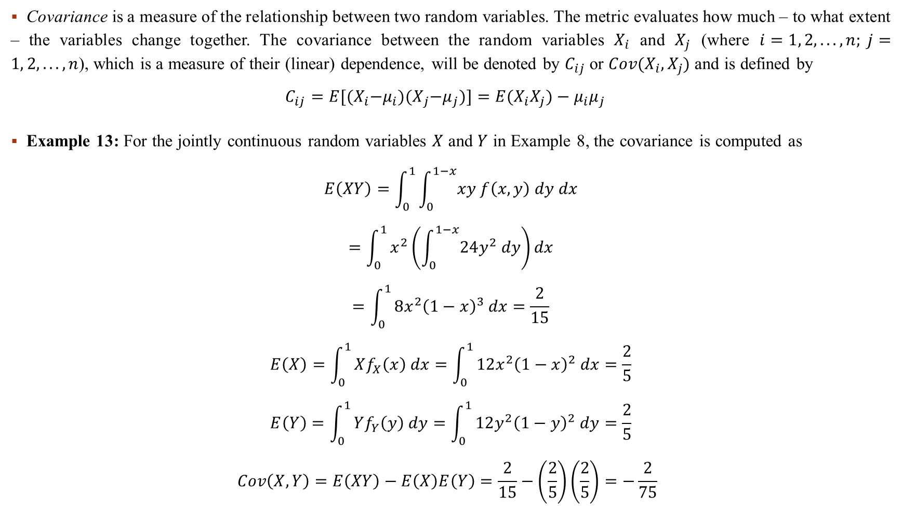
Covariance
Covariance is a measure of the relationship between two random variables. The metric evaluates how much – to what extent – the variables change together. The covariance between the random variables $X_{i}$ and $X_{j}$ (where $i=1, 2, . . . , n; j=1, 2, . . . , n$), which is a measure of their (linear) dependence, will be denoted by $C_{ij}$ or $Cov(X_{i}, X_{j})$ and is defined by
$$C_{ij}=E[{(X}_{i}−μ_{i}){(X}_{j}−μ_{j})]=E(X_{i}X_{j})−μ_{i}μ_{j}$$
Example 13: For the jointly continuous random variables $X$ and $Y$ in Example 8, the covariance is computed as
$$E\left(XY\right)=\int_{0}^{1}{\int_{0}^{1−x}{xy f\left(x,y\right) dy dx}}$$
$$=\int_{0}^{1}{x^{2}\left(\int_{0}^{1−x}{24y^{2} dy}\right)dx}$$
$$=\int_{0}^{1}{8x^{2}{\left(1−x\right)}^{3} dx=\frac{2}{15}}$$
$$E\left(X\right)=\int_{0}^{1}{Xf_{X}\left(x\right) dx=\int_{0}^{1}{12x^{2}{\left(1−x\right)}^{2} dx=\frac{2}{5}}}$$
$$E\left(Y\right)=\int_{0}^{1}{Yf_{Y}\left(y\right) dy=\int_{0}^{1}{12y^{2}{\left(1−y\right)}^{2} dy=\frac{2}{5}}}$$
$$Cov\left(X,Y\right)=E\left(XY\right)−E\left(X\right)E\left(Y\right)=\frac{2}{15}−\left(\frac{2}{5}\right)\left(\frac{2}{5}\right)=−\frac{2}{75}$$

Slide 152
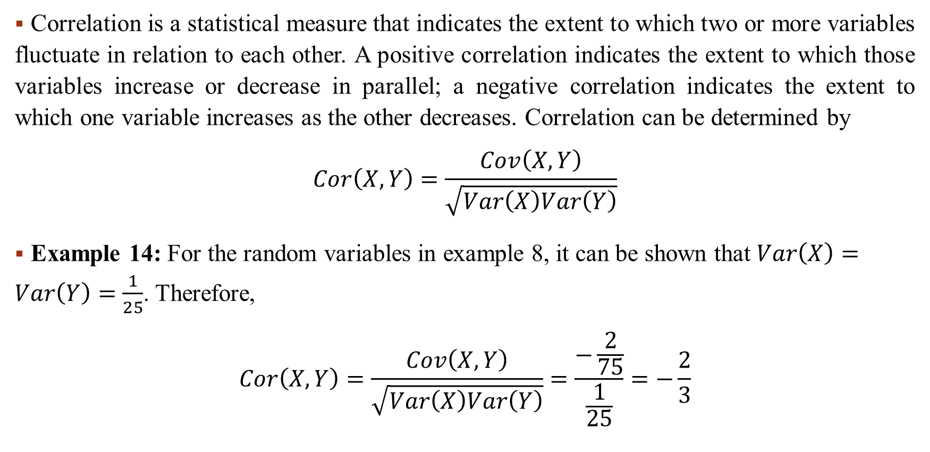
Correlation
Correlation is a statistical measure that indicates the extent to which two or more variables fluctuate in relation to each other. A positive correlation indicates the extent to which those variables increase or decrease in parallel; a negative correlation indicates the extent to which one variable increases as the other decreases. Correlation can be determined by
$$Cor\left(X,Y\right)=\frac{Cov\left(X,Y\right)}{\sqrt{Var\left(X\right)Var\left(Y\right)}}$$
Example 14: For the random variables in example 8, it can be shown that $Var\left(X\right)=Var\left(Y\right)=\frac{1}{25}$. Therefore,
$$Cor\left(X,Y\right)=\frac{Cov\left(X,Y\right)}{\sqrt{Var\left(X\right)Var\left(Y\right)}}=\frac{−\frac{2}{75}}{\frac{1}{25}}=−\frac{2}{3}$$

Slide 153
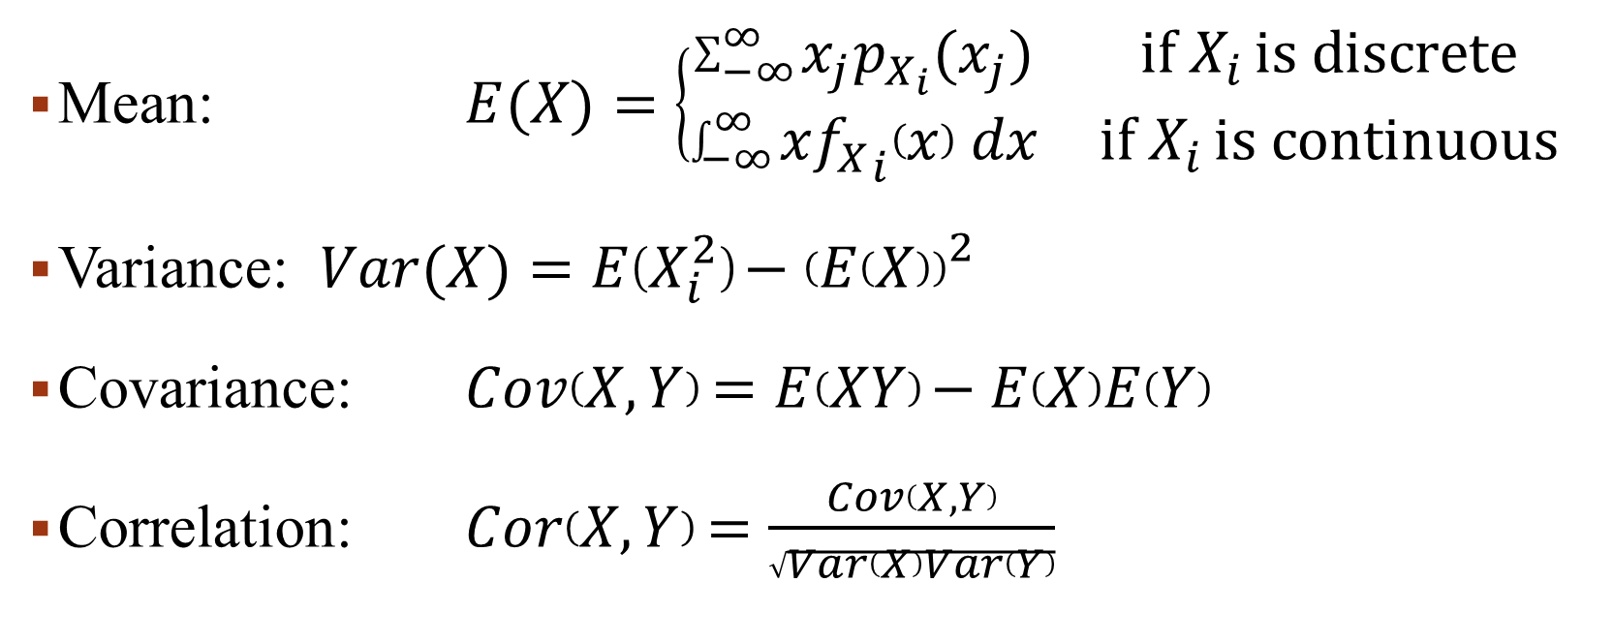
Important formulas to calculate Correlation
Mean: $E(X)=\left\{\begin{matrix}\sum_{−∞}^{∞}{x_{j}p_{X_{i}}(x_{j})} & \text{if} X_{i }\text{is} \text{discrete} \\ \int_{−∞}^{∞}{x{f_{X}}_{i}\left(x\right) dx} & \text{if} X_{i }\text{is} \text{continuous}\end{matrix}\right.$
Variance: $Var(X)=E\left(X_{i}^{2}\right)−{\left(E\left(X\right)\right)}_{}^{2}$
Covariance: $Cov\left(X,Y\right)=E\left(XY\right)−E\left(X\right)E\left(Y\right)$
Correlation: $Cor\left(X,Y\right)=\frac{Cov\left(X,Y\right)}{\sqrt{Var\left(X\right)Var\left(Y\right)}}$

Slide 154
Week 15
Slides 154-163

Slide 155
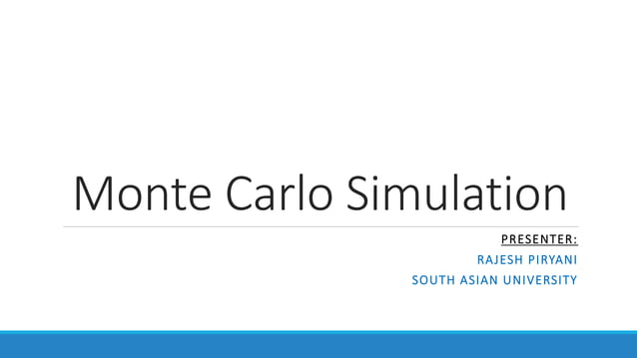

Slide 156


Slide 157


Slide 158


Slide 159


Slide 160


Slide 161


Slide 162


Slide 163


Slide 164
Week 16
Slides 164-176

Slide 165


Slide 166


Slide 167


Slide 168


Slide 169


Slide 170


Slide 171


Slide 172


Slide 173


Slide 174


Slide 175


Slide 176


Slide 177
Week 17
Slides 177-200

Slide 178


Slide 179


Slide 180


Slide 181


Slide 182


Slide 183


Slide 184


Slide 185


Slide 186


Slide 187


Slide 188


Slide 189


Slide 190


Slide 191


Slide 192


Slide 193


Slide 194


Slide 195


Slide 196


Slide 197


Slide 198


Slide 199


Slide 200


